Slide 1
New Mexico Environment Department
Diesel Emissions Reduction Act Grant Funding
Neal Butt, Environmental Analyst
January 9, 2023

Slide 2
DERA Funding Opportunity
Application period will open on February 1, 2023, and stay open until the end of the year, or until the Grant funding is exhausted, whichever comes first.
Applications will be evaluated, and successful applicants will be awarded funds, on a first-come first-served basis.
Applications should be sent to me at neal.butt@env.nm.gov
Currently $1,306,463 available to award
$252,069 available for replacement of diesel vehicles Engine Model Years 1995 to 2006 with new clean diesel or alternative fueled vehicles or equipment.
$615,238 available for EMY 1996 to 2009.
$439,156 available for EMY 2009 and older.
If you are replacing a diesel vehicle or engine with electric, then you can retire EMY 2010 and newer.

Slide 3
Diesel Emissions Reduction Act
As a result of EPA regulations, diesel engines manufactured today are cleaner than ever before. But because engines can operate for 30 years or more, millions of older, dirtier engines are still in use.
Combustion of diesel fuel produces nitrogen oxides (NOx), fine particulate matter (PM 2.5) carbon dioxide and air toxics. Reducing exposure to diesel exhaust is especially important for human health and the environment. (e.g., asthma, ground-level ozone, acid rain, haze)
NMED provides grant funding through the New Mexico Clean Diesel Program, for projects that reduce harmful diesel emissions from existing heavy-duty diesel-fueled vehicles and equipment. This program is funded by EPA through the Diesel Emission Reduction Act or “DERA”.
2005 - Congress passed the Diesel Emissions Reduction Act (DERA) amending the Energy Policy Act of 2005. Designed to reduce diesel emissions from existing diesel fleets that did not meet the federal emission standards at that time.
EPA is responsible for overseeing and distributing the DERA funds. For more information visit EPA’s DERA Funding website https://www.epa.gov/dera

Slide 4
New Mexico Clean Diesel Program
Duke City Redi-Mix - Replaced five 1997 model year (MY) Kenworth concrete mixer trucks without emissions control devices installed; with 2022 MY Kenworth T880S trucks outfitted with Con-Tech Manufacturing mixer bodies, equipped with 2021 MY diesel engines that meet the current emission standards.
Estes Express Lines Inc. – Replaced four 2007 MY International, Model 8600 diesel-fueled Class 8 single axle freight hauling trucks with new, lower-emission 2022 MY International LT625 4x2 (LT62A) diesel vehicles.
Department of Cultural Affairs – State Library - Replacing a 2009 MY Bluebird - All American school bus retrofitted to serve as a bookmobile, with a new as-built bookmobile manufactured by Matthews Specialty Vehicles.
Acme Iron and Metal – Replacing a 1997 MY, Tier 1, 250hp Fuchs diesel-powered, rubber-tire scrap metal material handler with a 2022 MY Sennebogen 850 “E” Electric Material Handler.

Slide 5
DERA Grant - Eligibility
Public or private entity or nonprofit organization, in New Mexico for three consecutive years, and whose vehicles/equipment are registered, (or have an International Registration Plan if applicable) in New Mexico.
Idle reduction technologies, aerodynamic technologies, and the retrofit or replacement of diesel vehicles and equipment.
EPA or California Air Resources Board (CARB) verified/certified technologies or vehicle, engine or equipment replacement utilizing a zero-tailpipe emissions power source.
Buses (school and Class 5+ transit); Class 5 – Class 8 heavy-duty highway vehicles (e.g., refuse, commercial transportation); marine engines; locomotives; and nonroad engines, equipment, or vehicles such as those used in construction, handling of cargo (including at ports and airports), agriculture, mining, or energy production (including stationary generators and pumps).

Slide 6
DERA Grant - Eligibility (Continued)
Existing vehicle, engine, or equipment must be fully operational.
Own and operate the existing vehicle or equipment during the two years prior to upgrade.
Existing vehicle, engine, or equipment must have three years of remaining life at the time of upgrade.
Remaining life is the fleet owner’s estimate of the number of years until the unit would have been retired from service if the unit were not being upgraded or scrapped because of this grant funding.
Existing on-road vehicle must have accumulated at least 7,000 miles/year during the two years prior to upgrade; or during calendar year 2019 for school buses.
Replacement vehicle, engine or equipment should resemble the replacement in form and function.
Funding cannot be used for the purchase of vehicles, engines, or equipment to expand a fleet.

Slide 7
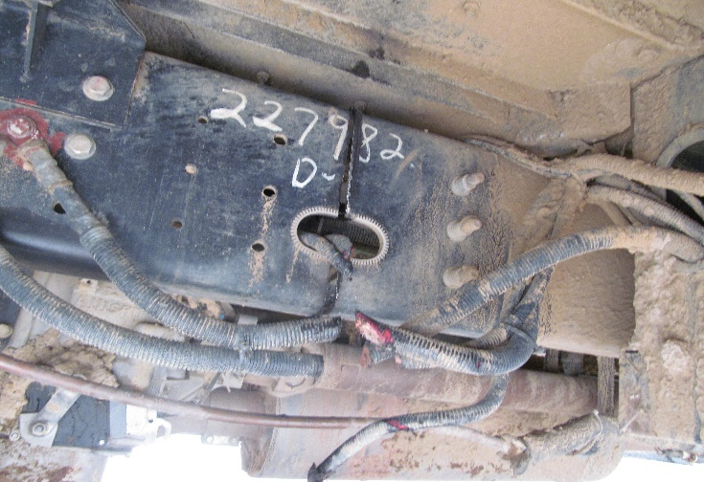
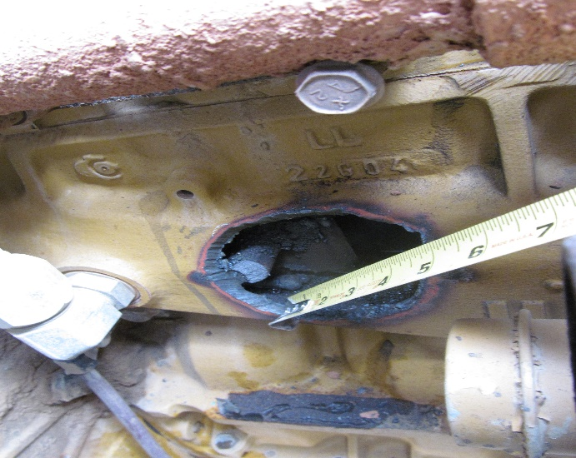
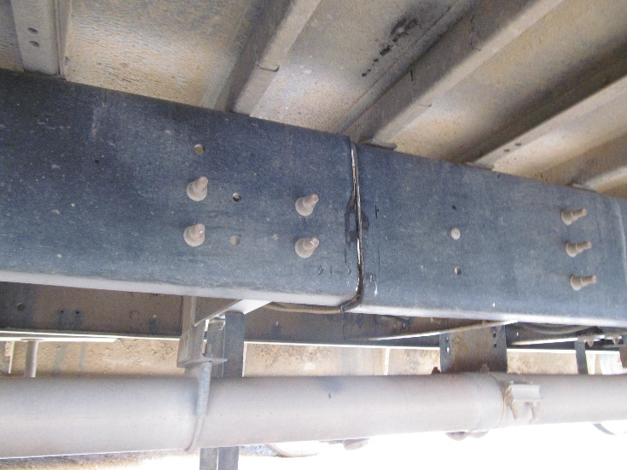
DERA Grant – Scrapping Vehicle, Engine or Equipment
Scrapped or disabled within 90 days of being replaced
Equipment and vehicle components not part of engine or chassis may be salvaged
Drill three-by-three-inch hole in engine block and disable chassis by cutting through the frame rails on each side
Scrappage statement signed by the vehicle owner and the dismantler is required

Slide 8
Preference and Special Consideration
Preference given to projects utilizing hydrogen fuel cell technology.
Certified engine replacements - Hydrogen fuel cells are an option for eligible urban transit buses and drayage trucks.
Certified/Verified vehicle and equipment replacements – hydrogen fuel cell vehicles and equipment are eligible as replacements for eligible transit buses, shuttle buses, drayage trucks, terminal tractors/yard hostler, stationary generators and forklifts.
“Drayage Truck” any Class 8 (GVWR > 33,000 lbs.) highway vehicle operating on or transgressing through port or intermodal rail yard property for the purpose of loading, unloading, or transporting cargo, such as containerized, bulk or break-bulk goods.
Special consideration will be given to projects near and adjacent to:
Non-attainment areas
Class I areas
Areas subject to a high volume of diesel-fueled vehicles, and
Economically disadvantaged areas.
Information about these types of areas can be found in the NMED Clean Diesel Program Guidance Document posted on our website.

Slide 9
Application – Organization Information
Organization Information – 40 Points
Project Title | Windy City Solid Waste Vehicle Replacement Project
Number of Vehicles | #
Organization Name | Windy City Public Works Department
Responsible Official | Responsible for funding; signature authority; and oversight for the project |  |  | Title |  |  |  | Title | Title
Mailing Address
City, State, Zip |  |  |  | Phone Number
Cell Number |  |  |  | Email
Organization’s Unique Entity ID vs. D-U-N-S Number | Applicants for a DERA Grant must have an Active Registration on SAM.gov and be in good standing at the time of Award. You may apply for a DERA Grant while your SAM.gov registration is being processed if you do not already have a SAM.gov account.
Contact Person | Department’s primary contact. Can be the same as “Responsible Official”. |  |  | Title |  |  | Title
Phone Number |  |  |  | Email |  |  | Email
Organization Type | ☐ State ☒City ☐ County ☐School District ☐ Non-Government ☐ Other, list: Individuals are not eligible to receive funds unless they are applying on behalf of a public entity or private entity or nonprofit organization.
Fleet Address
City |  | County |  |  |  | Zip Code

Slide 10
Application – Description of Applicant’s Organization
Description of Applicant’s Organization – 10 Points
Describe your organization’s size and type of work performed. If the proposed vehicle(s) operate outside of the State¹, provide the percentage of time your organization will operate the affected equipment within New Mexico. Include other information, such as number of hours and/or miles traveled within the State. Also include any environmental measures utilized by the organization, such as anti-idling policies that reduce emissions.
Appendix A- Documentation Verifying the Operating Time in New Mexico. NMED does not have a standardized template, so however the applicant is able to document the estimated number of hours and/or miles traveled in the State showing that the equipment operates within the State at least 75% of the time will be acceptable. If your vehicle does not operate outside of New Mexico, then verification is not necessary.
1. Vehicles/equipment must operate within the State at least 75% of the time. The applicant MUST provide documentation verifying the operating time within the state as Appendix A.

Slide 11
Application – Project Funding
Project Funding – 5 Points
Funding Requested | $ 250,000
Cost Share + | $ 750,000 | %
Project Cost = | $1,000,000
Scrap Value - | $ 1,000
Total Project Cost* | $ 999,000
Will a funding waiver be requested ☐ Yes ☐ No If the applicant is unable to meet the specific required cost share for that type of project as stipulated by the guidance, and requests that the percentage contributed by EPA be increased. NMED will consider, on a case-by-case basis, and submit to EPA for approval, requests for waivers from programmatic requirements; only for non-statutory or non-regulatory requirements. The State must obtain EPA approval for any waiver request before commencing any work or the expenditure of funds on a project involving a waiver request.
If yes, the applicant will need to provide a detailed justification for the waiver if selected.
Is the applicant interested in the funding if a waiver request is denied? ☐ Yes ☐ No
*Total project cost for engine and vehicle replacements is the project cost minus scrap value from disabled engine or vehicle.

Slide 12
Application – Project Location
Project Location – 5 Points
Will the vehicle(s) reside within New Mexico? ☐ Yes ☐ No
Will the vehicle(s) permanently reside at the project address? ☐ Yes ☐ No
Will the vehicle(s) operate under an International Registration Plan? ☐ Yes ☐ No
If “No” to either of the first two questions above, or “Yes” to the third question, provide a detailed explanation in the Project Location Summary below.
Details to address in the Project Location summary shall include: A detailed description of the primary area(s) where the affected vehicle/engine operates, or the primary area where the emissions benefits of the project will be realized; A description of the routes and estimated miles traveled; and A summary of whether the project will be sited in an area where all or part of the population is exposed to diesel emissions. For those fleets that travel statewide, provide a percentage of time spent in the various locations. A map of the project location is required to be included as Appendix B.

Slide 13
Application – Fleet/Equipment Description
Fleet/Equipment Description¹ – 5 Points
Provide Vehicle Information Sheet as Appendix C {standardized form posted on website} and the fleet’s vehicle replacement policy or schedule as Appendix D. Provide detailed summary of old equipment (make, model, year). Summarize the expected useful lifetime of the project-funded vehicle(s)/equipment and how it will be used by organization, including a description of how the applicant’s vehicle replacement procedures meet the attrition/fleet turnover requirements below. Describe why this project would not have occurred without these funds.
Appendix D- Fleet Replacement Schedule. NMED does not have a standardized template. Outline the company’s standard procedure for vehicle replacement (e.g., company document, explanation of when the specific vehicle type is normally replaced by the company). For public agencies, there are usually formalized retirement periods (e.g., statutory retirement of school buses).
1. Funds cannot be used for emission reductions that result from vehicle/equipment replacement or repowers that would have occurred through normal attrition/fleet turnover within three years of the project start date. Complete the Use of Funds Restrictions Form {standardized form posted on website} and attach to the application package as Appendix E. (1. Normal attrition/Fleet turnover; 2. Fleet expansion; 3. Vehicle scrappage)
Normal Attrition: Engine, vehicle, and equipment replacements that would have occurred through normal attrition are considered to be the result of normal fleet turnover and are not eligible for funding under this program. Normal attrition is defined as a replacement that is scheduled to take place within 3 years of the project start date; and typically defined by the vehicle or fleet owner’s budget plan, operating plan, standard procedures, or retirement schedule.

Slide 14
Application – Expected Environmental Outputs from Project
Expected Environmental Outputs from Project– 70 Points
Provide a detailed summary of expected environmental outputs associated with this project. The term “output” means an environmental activity, effort and/or associated work product related to an environmental goal and objective that will be produced or provided over time or by a specified date. Outputs may be quantitative or qualitative but must be measurable during an assistance agreement funding period. Specify the proposed technologies that will be used for this project, including why the specific technology was selected. With the exception of all-electric technologies, grant funding may only be used for EPA or CARB verified or certified technologies. Review the NMED CDP Guidance for: a complete listing of eligible equipment (i.e., Eligible Diesel Emissions Reductions Solutions); additional project outputs to be included in the summary (Include the number of years that the technology will remain in the fleet); and for a list of project outputs.

Slide 15
Application – Project Outcomes/Project Benefits
Project Outcomes/Project Benefits – 60 Points
Total Project Lifetime Emission Results (tons)¹ and Cost Effectiveness
Pollutant or Fuel | NOx | PM_{2.5} | HC | CO | Fuel(s)
Amount reduced after upgrades | # Tons | # Tons | # Tons | # Tons | # Gallons
Cost Effectiveness | $$$ | $$$ | $$$ | $$$
1. Applicants must use the EPA Diesel Emissions Quantifier (DEQ). The DEQ will calculate Cost Effectiveness ($/short ton reduced) based on your inputs. Include a copy of the DEQ report as Appendix F.
NMED requires that all applicants use the USEPA Diesel Emissions Quantifier (DEQ) for the emission calculation and cost effectiveness, this can be found at: https://cfpub.epa.gov/quantifier/index.cfm?action=main.home . The applicant must provide a copy of the DEQ report as Appendix F. The applicant must complete the Total Lifetime Results and Cost Effectiveness table. The information provided in this table is for the total project, not for the individual units.

Slide 16
Demonstration of Diesel Emissions Quantifier tool

Slide 17
Demonstration of Diesel Emissions Quantifier tool

Slide 18
Demonstration of Diesel Emissions Quantifier tool

Slide 19
Demonstration of Diesel Emissions Quantifier tool

Slide 20
Demonstration of Diesel Emissions Quantifier tool

Slide 21
Demonstration of Diesel Emissions Quantifier tool

Slide 22
Demonstration of Diesel Emissions Quantifier tool

Slide 23
Demonstration of Diesel Emissions Quantifier tool

Slide 24
Demonstration of Diesel Emissions Quantifier tool

Slide 25
Demonstration of Diesel Emissions Quantifier tool

Slide 26
Demonstration of Diesel Emissions Quantifier tool

Slide 27
Application – Public Health Benefits
Public Health Benefits – 30 Points
Describe how project will: Meet requirements of DERA by reducing environmental risks to the public and sensitive populations; and reduce environmental risks to economically disadvantaged and other populations with disproportionately high and adverse human health or environmental impacts. Include impacted communities including total population, percent minority, percent low-income (defined as $25,000 annually, or less), and proximity to hospitals, medical, elderly facilities, and school(s), including daycare. Include map showing locations of these facilities relative to the project area. Use EPA’s EJSCREEN: Environmental Justice Screening and Mapping Tool for minority population and low-income data. Attach EJSCREEN ACS Summary report as Appendix G and a map that shows the locations of affected facilities as Appendix H. Low-income is derived from the Office of the Assistant Secretary for Planning and Evaluation Poverty Guidelines, using data for a family of four with an annual income of $26,200 or less. See ACS report, Page 2, “Households by Household Income.” Add the first two percentages from the categories “<$15,000” and “$15,001 - $25,000” to determine the percentage of low-income households in the project area. Include the EJSCREEN map.
For fleet projects that service multiple areas throughout the State, provide a detailed summary of the route, an EJSCREEN report as Appendix G and a map for each area serviced as Appendix H, along with the percentage of time the fleet spends in the affected area

Slide 28
Demonstration of EJSCREEN

Slide 29
Demonstration of EJSCREEN
1
2
3
4

Slide 30
Demonstration of EJSCREEN

Slide 31
Demonstration of EJSCREEN

Slide 32
Demonstration of EJSCREEN

Slide 33
Demonstration of EJSCREEN
23%

Slide 34
Application – Air Quality in the Project Location
Air Quality in the Project Location – 30 Points
Describe any special air quality concerns within or in close proximity to, the project area (e.g., located in an ozone nonattainment area, nearby Federal Class I areas, EPA designated priority counties) and include a qualitative description of the area’s diesel emissions due to high impact features (e.g., truck stops, railroad yards, distribution centers, interstates, etc.).
Describe how the project will reduce environmental impacts in the project location as it pertains to the air quality standards and proximity to Class I Areas. Indicate whether the project is located: Within or adjacent to a non-attainment area for the NAAQS for ozone (currently Sunland Park in Doña Ana County); Within a county whose ozone design value is equal to or greater than 95% of the NAAQS for ozone (currently Doña Ana, Lea, Eddy, San Juan, Rio Arriba, Sandoval, Valencia and Bernalillo); or Within or near a designated priority county listed in the NMED Clean Diesel Program Guidance Document Describe the proximity (in miles) to the nearest Class I Area. If there are additional Class I Areas within 100 miles, list all of them. A map of the Federal Class I Areas within the State and in surrounding areas can be found at: https://www.env.nm.gov/air-quality/reg-haze/ Include a map, showing proximity to Federal Class I Areas relative to the project area as Appendix I.

Slide 35
Application – Community Engagement and Partnership
Community Engagement and Partnership – 5 Points
List any government entities, school districts or organizations involved in this project, including their roles in the project.
Provide a summary that outlines project partners involved in this project and any community activities associated with this project. Project partners include government entities, school districts or community organizations.

Slide 36
Application – Fuel Type
Fuel Type – 30 Points
Fuel Type of Proposed Vehicles: ☐ ULSD ☐ CNG/LNG ☐ Propane ☐ Near zero CNG ☐ Electric ☐ Hydrogen Fuel Cell
Are additional fueling infrastructure developments or improvements needed for this project? If yes, describe below. | ☐ Yes ☐ No
Select all applicable fuel types for the proposal. Projects are not limited to using one fuel type; projects can use multiple fuel types such as compressed natural gas (CNG) or electricity (electric vehicles - EV). Should the project, as proposed, require additional fueling infrastructure, provide a detailed summary of the infrastructure that will be needed for this project including dates of completion that correspond to the project completion date.

Slide 37
Application – Ability to be Deployed in a Timely Manner
Ability to be Deployed in a Timely Manner – 5 Points
Provide a detailed description, including estimated time of delivery and the purchasing process.
Provide a description/summary discussing the estimated time of delivery for equipment or vehicles to include a brief discussion of the applicant’s purchasing procedures.

Slide 38
Application – Purchasing Procedures
Purchasing Procedures – 5 Points
Provide a detailed summary of the applicant’s purchasing procedures ensuring that all vendors will be selected in accordance with state public contracting and procurement regulations and federal procurement regulations.
The applicant must follow state purchasing procedures, as applicable, found at: www.generalservices.state.nm.us/statepurchasing/ ; New Mexico Procurement Code, Sections 13-1-28 through 13-1-199 NMSA 1978, as applicable; and the applicable requirements contained at 2 CFR 200, Office of Management and Budget Guidance – Uniform Administrative Requirements, Cost Principles, and Audit Requirements for Federal Awards; in particular Procurement Standards at 2 CFR 200.317 – 200.326, found at https://www.ecfr.gov/current/title-2/subtitle-A/chapter-II/part-200/subpart-D . This must include price agreements in place, bidding processes or other purchasing procedures.

Slide 39
Application – Previous Grant Experience
Previous Grant Experience – 5 points
Provide a brief summary of previous grant experience, including the year awarded, the funding organization, and the purpose of the grant funding. Also indicate whether any funded projects were not completed and provide an explanation of why these projects were not completed.
If all projects were completed, please indicate this in one sentence.

Slide 40
EPA Clean School Bus Program
$1 billion of a five-year, $5 billion program created by the Bipartisan Infrastructure Law. EPA is planning the next rounds of the program; will make available another $1 billion in FY 2023; and encourages school districts not selected in the first round of rebates – and those that did not apply this funding cycle – to participate in future rounds. [ https://www.epa.gov/cleanschoolbus ]
Phasing out diesel engines will ensure cleaner air for students, bus drivers, and school staff working near the bus loading areas, and the communities through which the buses drive each day. Diesel air pollution is linked to asthma and other conditions that harm students’ health and cause them to miss school, particularly in communities of color and Tribal communities.
Reducing greenhouse gas emissions (esp. CO₂) from bus replacements will help address outsized role of the transportation sector in fueling climate change.
Upgrading bus fleets will save money for school districts as they replace older, heavily polluting buses with new clean school buses, while freeing up needed resources for schools.

Slide 41
EPA Announces Clean School Bus Funding for School Districts in New Mexico
Electric Buses
Las Cruces $1,975,000
Dora Municipal Schools $610,000
Dulce Independent Schools $790,000.00
Lake Arthur Municipal Schools $790,000.00
Pecos Independent Schools $395,000.00
Vice President Kamala Harris laughs with EPA Administrator Michael Regan, during a tour of electric school buses at Meridian High School in Falls Church, Va., May 20, 2022.

Slide 42
Questions?
Neal T. Butt
Environmental Analyst
NMED - Air Quality Bureau
Santa Fe Office
525 Camino de los Marquez, Suite 1
Santa Fe, NM 87505-1816
(505) 629-2972
(505) 476-4375 (FAX)
Neal.Butt@env.nm.gov
www.env.nm.gov
Twitter @NMEnvDep | #iamNMED

