Slide 1
New Mexico Environment Department
PUBLIC INFORMATIONAL MEETING ON UPDATES TO AIR QUALITY PERMITTING FEES
Liz Bisbey-Kuehn, Air Quality Bureau Chief
March 20, 2024

Slide 2
Why Fee Increases are Needed
Increase in GCP-Oil and Gas permit applications of over 1600% between 2012 and 2023
754 GCP – Oil & Gas applications in 2023
Resources needed for some types of review are underestimated by the current fee structure
GCP-Oil and Gas
Air dispersion modeling reviews
Facilities applying for regular NSR permits are larger and have increased in complexity
New state air rule 20.2.50 NMAC (Ozone Precursor Pollutants from the Oil and Gas Industry) and federal air regulations increased the complexity of permitting and compliance determinations

Slide 3
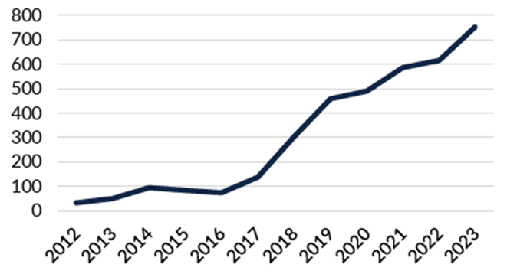
GCP-Oil and Gas Applications

Slide 4
Why Fee Increases are Needed
Additional staff and resources needed to keep pace with higher workload and to retain expert staff to evaluate more complex permit applications
Current fees per ton for Operating Permits are far below the “presumptive minimum fee” developed by US EPA for assessing fees sufficient to administer an operating permit program.
EPA presumptive minimum fee per ton = $61.73
Current New Mexico fee per ton = $38.47
New Mexico’s current fee is just over the 25th percentile of all states
Settlements collected by New Mexico’s Air Quality Bureau for enforcement actions do not become part of the air program budget (sent to state general fund)

Slide 5
Benefits of Increase in Fees
Increased permitting program capacity
Supports growth of New Mexico’s economy
Decreases the time to process complex permit applications
Enhanced technical assistance for applicants because each permit writer will have more time for review and resolution of issues, and changes to application
Increased compliance and enforcement program capacity
Emissions reductions due to increased oversight of compliance
Increasing permit fees may have the secondary benefit of reducing emissions. Permittees may reduce emissions to stay below certain permitting thresholds (Title V or PSD).

Slide 6
Proposed Changes to Regulations
Part 75 (Construction Permit Fees)
Filing fee for permit applications, including Notices of Intent (NOI), increase from $500 to $2,000 dollars and becomes tied to increases in the Consumer Price Index (CPI)
Increase in the number of points for some reviews under the point-based fee schedule:
Reviews of submitted air dispersion modeling revised from 15 points to 30 points
Reviews of General Construction Permits (GCP) for Oil and Gas revised from 10 points to 50 points
Reviews for other GCPs (concrete, asphalt, aggregate crushers, etc.) remain unchanged
Small business fee reduction continues
Electronic payment option added to regulation

Slide 7
Proposed Changes to Regulations
Part 71 (Operating Permit fees)
Fee pollutants revised to include PM_{2.5} and PM₁₀ and remove Total Suspended Particulates (TSP) and mercury. Fee only for emissions of PM₁₀ or PM_{2.5} whichever is higher.
Increase in the fee per ton for fee pollutants and Hazardous Air Pollutants (HAPs)
Fee pollutants (NO₂, SO₂, CO, VOCs, PM₁₀ or PM_{2.5} ) increased to $81 per ton
Fee for HAPs increased to $250 per ton
Administrative compliance cost for enforcement actions added
Electronic payment option added to regulation

Slide 8
Estimated Change to Fees
Type of facility | Type of fee | Current fee | Proposed Fee
Regular NSR | Air dispersion modeling fee | $7,650 | $15,300
GCP-O&G | Application | $5,100 | $25,500
Other (construction industry) GCPs | Application | $5,100 | $5,100
Notice of Intent (NOI) | Application filing fee | $500 | $2,000
All other types of facilities | Application filing fee | $2,000 filing fee credited against total permit app fee, so no net change in total cost
Title V fee pollutant | Annual fee per ton | $38.47 | $81
Title V HAP | Annual fee per ton | $244.51 | $250

Slide 9
Next Steps
The Petition and Statement of Reasons for the proposed changes to the fee regulations was filed with Environmental Improvement Board on 3/7/24 as EIB 24-12.
These documents are available on the webpage at https://www.env.nm.gov/opf/docketed-matters under the EIB heading
On Friday 3/22/24, NMED will request a June hearing before the EIB. Other parties may participate in the hearing and submit Notices of Intent to present technical testimony.

Slide 10
Questions and Discussion
Are there questions from the meeting attendees?
Are there concerns or issues you’d identified and would like to bring up at this point?
Does your organization/group want to meet separately with us about the proposed changes to the regulations?
Contact for questions and requests for additional meetings: EPD Division Director Michelle Miano michelle.miano@env.nm.gov or AQB Planning Section Chief Kirby Olson Kirby.olson@env.nm.gov and (505) 629-5107

