Slide 1
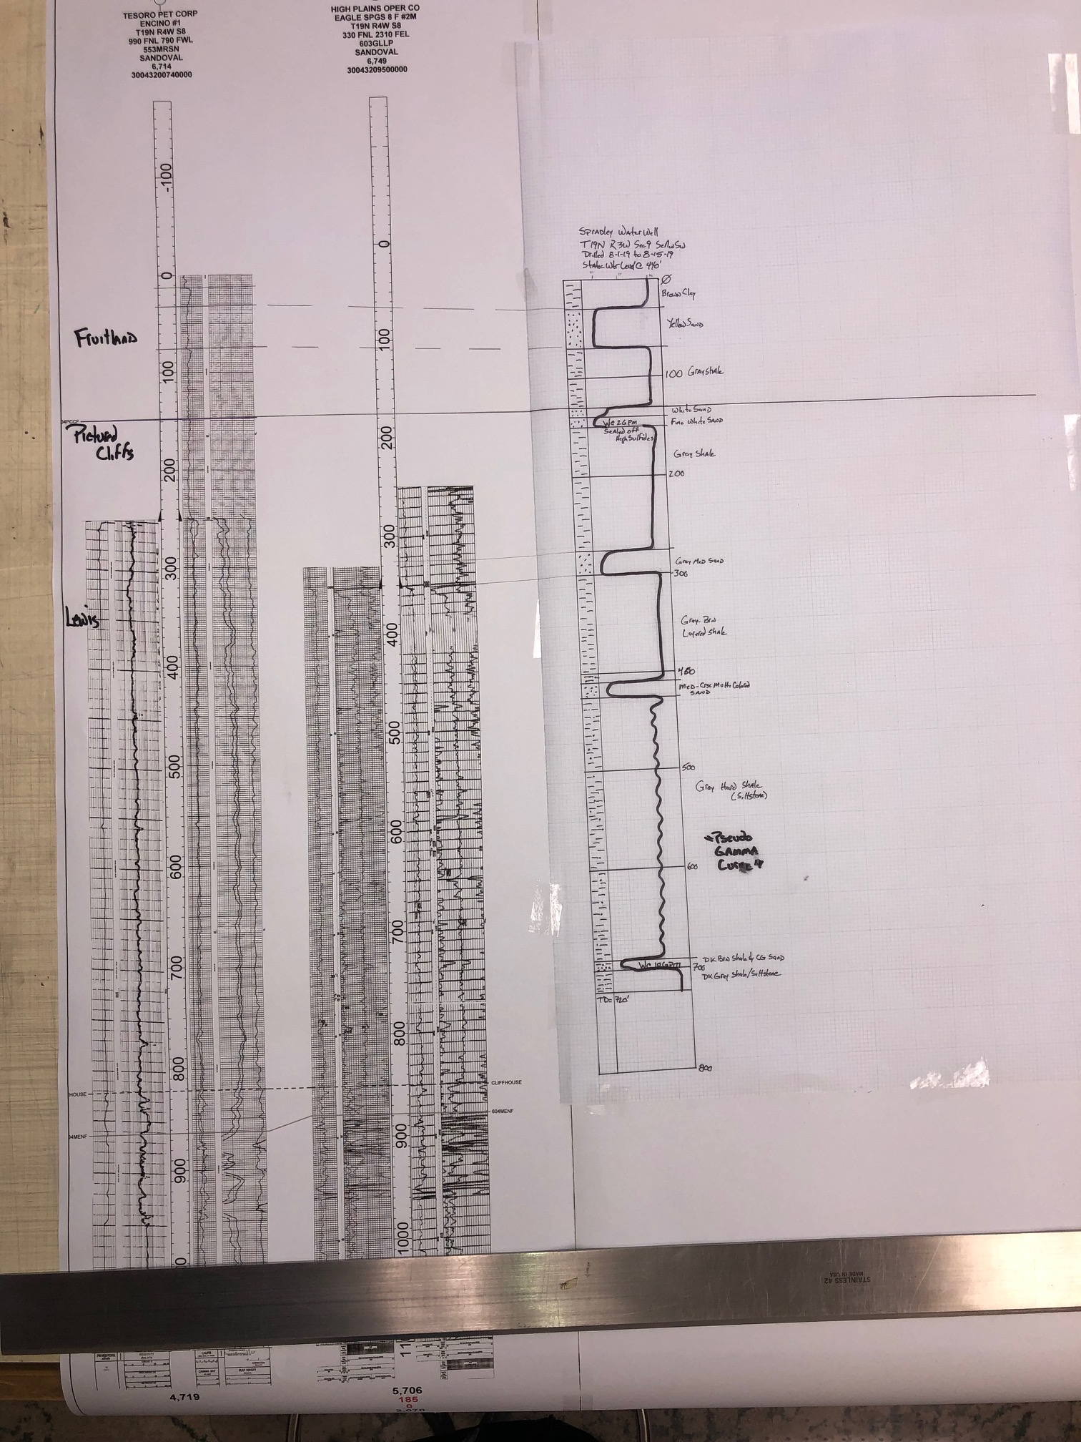
Gamma Ray Logs
Water Well Correlation Section:
This is a best-efforts correlation section to tie the Encino #1 (Gamma Ray to Surface), HPOC Eagle Springs 8 F #2M, and the Spradley water well.
The hand drawn curve on Spradley water well is a approximated Gamma Ray curve that is based upon the rock type found at the correlative depth interval.
A 40’ thick Fruitland sand was found in the Spradley well. No water was found in this sand. The assumption has to be that the sand was either too tight to produce or was air filled.
Appears that there is no water bearing sands above 300 ft.
All text can be clearly read by increasing the scale to 200%.
W = Reported Water Entry with Rate
Porosity Logs

