Slide 1
New Mexico Environment Department
Harmful Algal Blooms (HABs) Program
Lynette Guevara, Program Manager
SWQB Monitoring, Assessment, and Standards Section
November 18, 2025

Slide 2
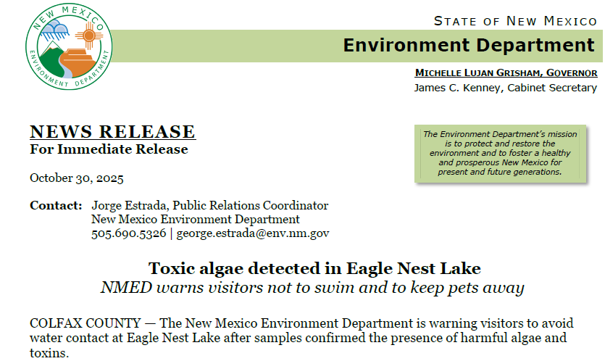
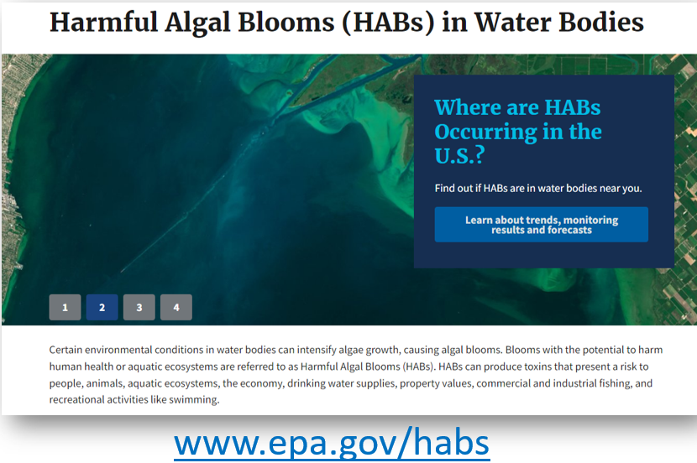
What is a Harmful Algal Bloom (HAB)?
Occur when certain cyanobacteria (a.k.a. blue-green ‘algae’) grow excessively in water, posing potential health risks to people and animals.
Appear blue, bright green, brown or red and may resemble scum or floating grass clippings on the water’s surface.
Have the potential to (but don’t always) produce toxins that are harmful to humans and animals.
Notes:
Harmful algal blooms (HABs) are overgrowths of algae in water that pose a health risk to people and animals. In New Mexico, some cyanobacteria blooms can produce cyanotoxins with a potential to severely affect human and animal health. Cyanobacteria (photosynthetic single-celled microscopic organisms) generally grow in lakes, ponds, and slow-moving streams when water is warm and stagnant. Cyanobacteria are commonly referred to as blue-green algae because they look very similar to algae.
In New Mexico’s larger lakes often observed in smaller coves

Slide 3
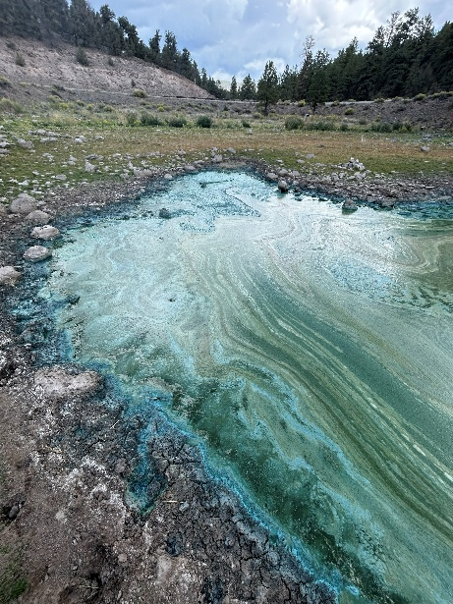
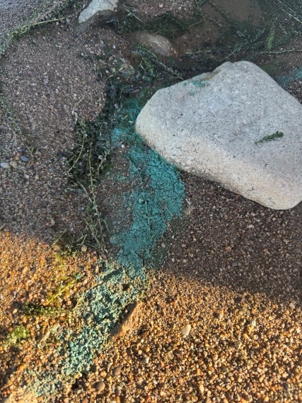
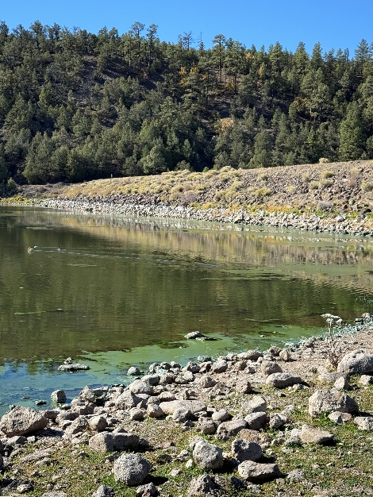
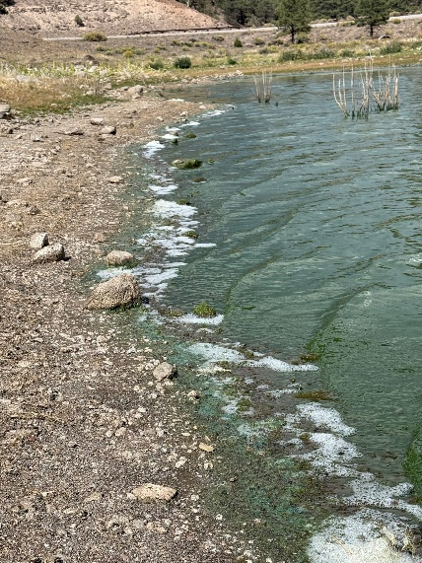
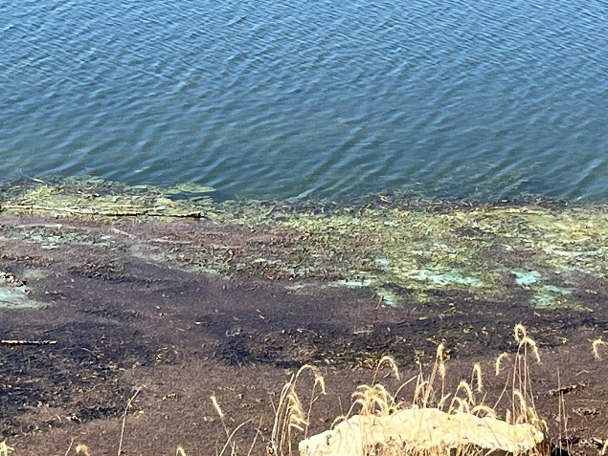
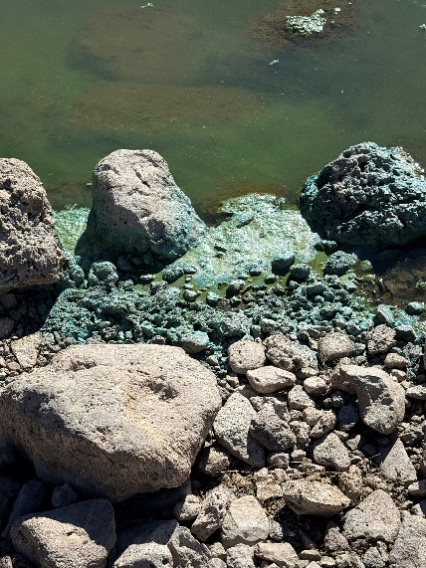
What do NM HABs Look Like?
Quemado Lake, October 2025
Eagle Nest Lake cell break down, October 2025
Maxwell Lake, Sept 2025
Notes:
HABs can look like grass clippings, blue-green scum, or spilled paint on the water surface. Blooms can be blue, bright green, brown or red. HABs may also be suspended in the water column or attached to rocks, sediments, or aquatic plants. Some blooms may not affect the appearance of the water but as algae in the blooms die, the water may smell bad.

Slide 4
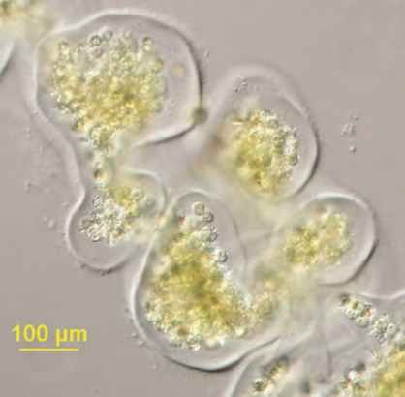
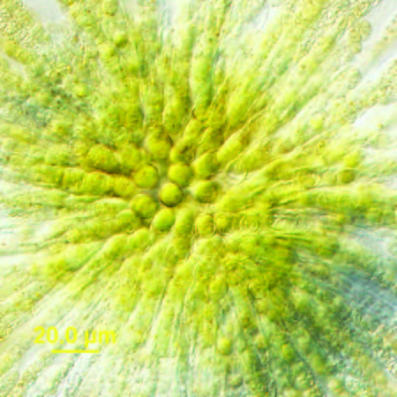
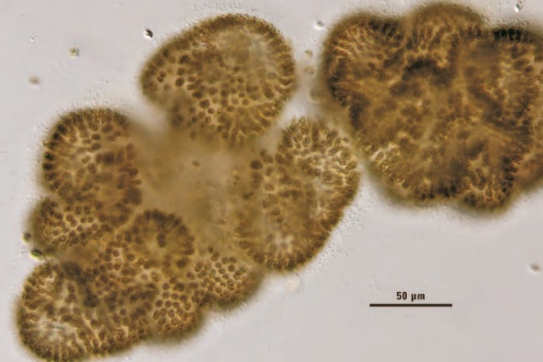
Cyanobacteria Facts
Around 3.5 million years old
Not technically algae but do produce chlorophyll a
Photosynthetic (many different pigments to optimize light capture)
Many types can control buoyancy (location in water column)
Reproduction by cell division (up to 3 doublings per day depending on temperature, nutrients and light)
Photo credit Barry H. Rosen
Notes:
----Many types can control buoyancy
Buoyancy to optimize exposure to light often results in pattern: rise to the surface during day/mid morning, production of sugars causes gas vesicles to collapse and sinks back down, at depth picks up enrichments from phosphorous releasing sediments
--Many types can incorporate atmospheric nitrogen into amino acids
--Reproduction by cell division. Can do 3 doublings per day!
3 doublings means going from 1 cell to 8 cells, needs right conditions ie temperature, nutrients and light

Slide 5
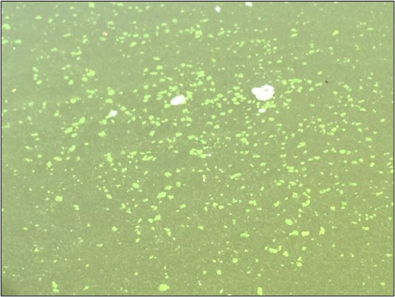
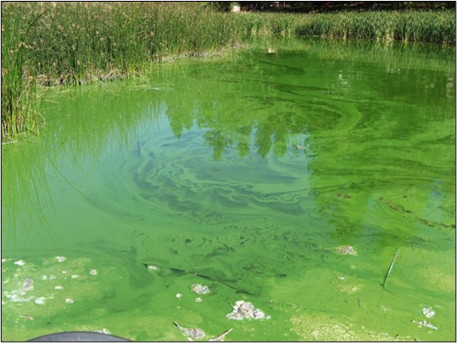
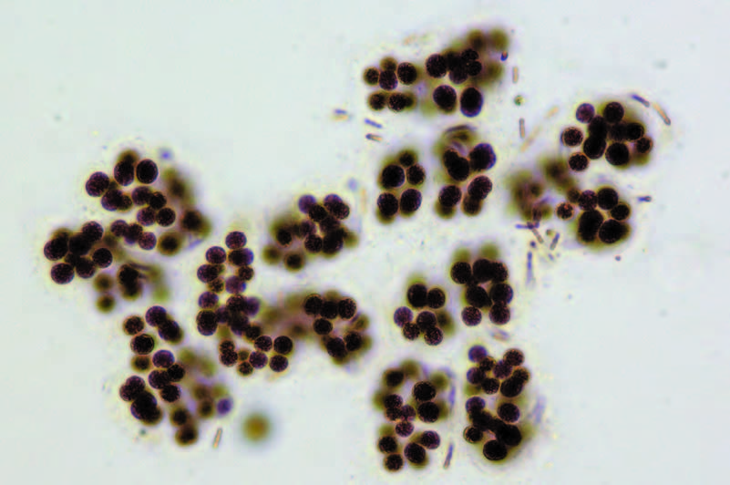
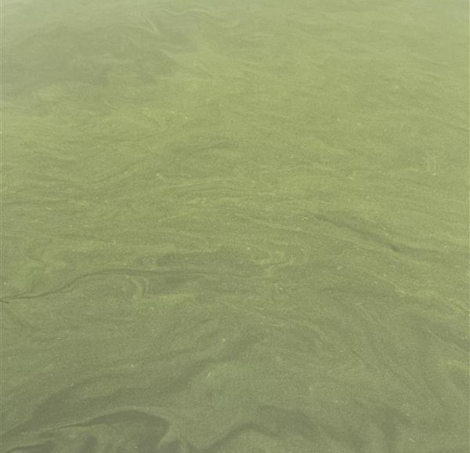
Microcystis
Microcystis sp. floating colonies (Photo credit CA SWAMP)
Microcystis sp. (Photo credit Jacob Kann, CA SWAMP)
Microcystis viridis. (Photo credit Ann St. Amand; Rosen et al., 2015)
Clayton Lake, September 2025
Notes:
Microcystis is the most common bloom-forming genus. Its blooms resemble a greenish, thick, paint-like (sometimes granular) material that accumulates along shores. Scums that dry on the shores of lakes may contain high concentrations of microcystin for several months, allowing toxins to dissolve in the water even when the cells are no longer alive or after a recently collapsed bloom.

Slide 6
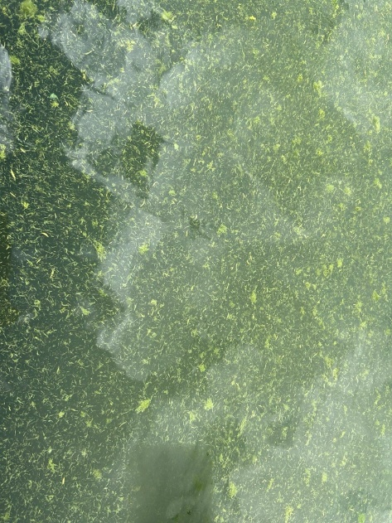
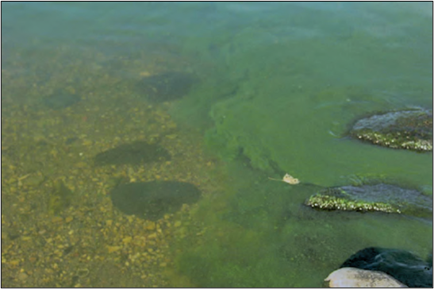
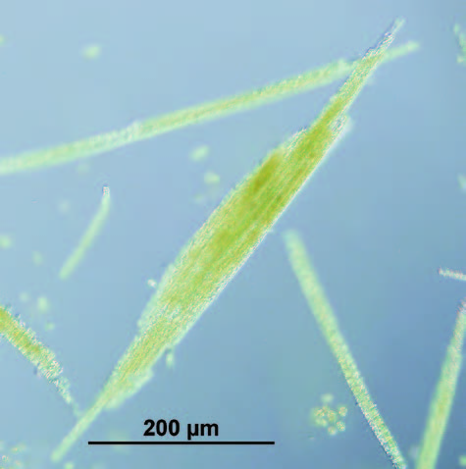
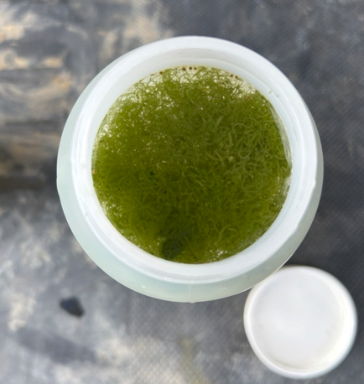
Aphanizomenon
Aphanizomenon flos-aquae. (Photo credit Ann St. Amand; Rosen et al., 2015)
Eagle’s Nest Lake, September 2025
Aphanizomenon flos-aquae. Filaments clustered
(Photo credit Barry H. Rosen; Rosen et al., 2015)
Aphanizomenon NM sample, September 2025
Notes:
Aphanizomenon flos-aquae often looks like grass clippings
Clustered form helps protect from grazing

Slide 7
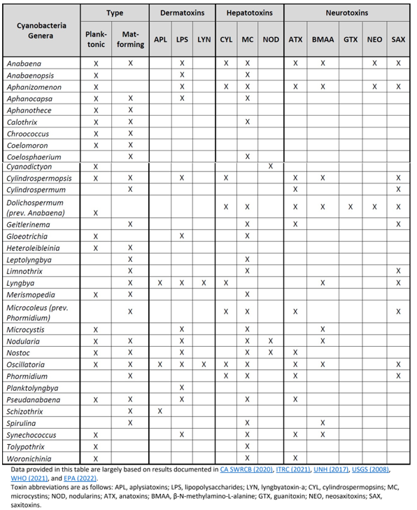
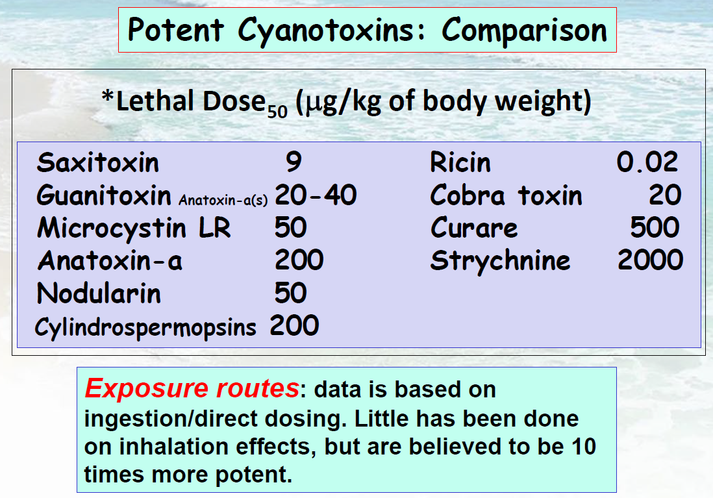
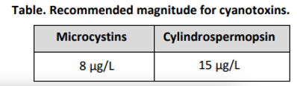
Cyanobacteria Cyanotoxins
Infographic from Barry H Rosen EPA presentation 10/18/23
In 20.6.4.900.D NMAC (New Mexico’s Water Quality Standards)
Table from 2023 Wyoming HCB Action Plan
Notes:
-This table shows toxin producing cyanobacteria and what toxins each one has the potential to produce
-Dermatoxins affect skin
Hours
-Hepatotoxins affect liver
Days to weeks
-Neurotoxins affect nervous system
Minutes
-A challenge to monitor and address because of the wide variety
-For example: Dolichospermum has potential to produce: Cylindrospermopsin, Microcystin, Anatoxin, BMAA, Guanitoxin, Neosaxitoxin and Saxitoxin
-Each Cyanotoxin requires its own test

Slide 8
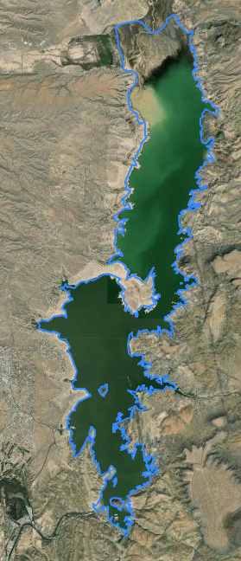
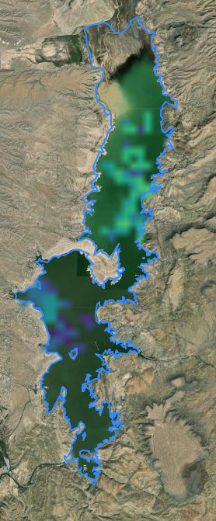
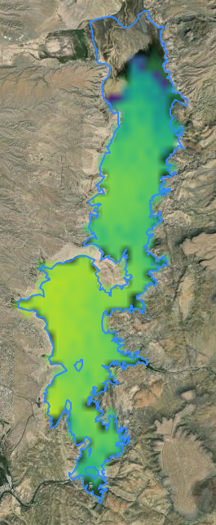
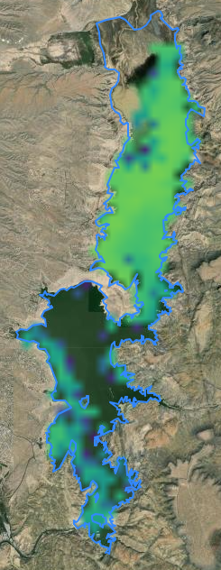
Cyanobacteria Assessment Network
Elephant Butte
7.9.23
7.16.23
7.30.23
8.6.23
Screenshots from CyAN web app
Notes:
-Real time data for monitoring Cyanobacteria in Lakes
-NMED and UT DEQ collaborators on Tetra Tech NASA proposal to develop a virtual satellite “orange band” to improve satellite-based monitoring for smaller lakes

Slide 9
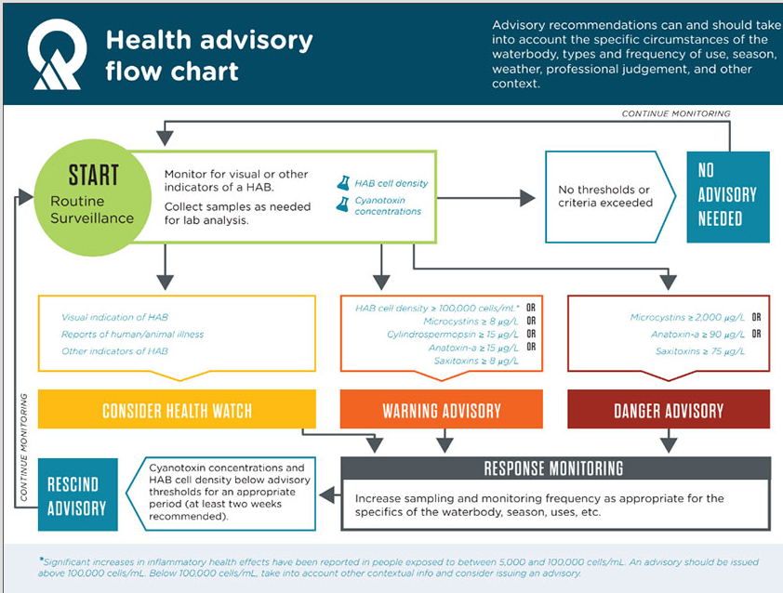
When to issue what type of advisory?
Example of Utah DEQ decision tree

Slide 10
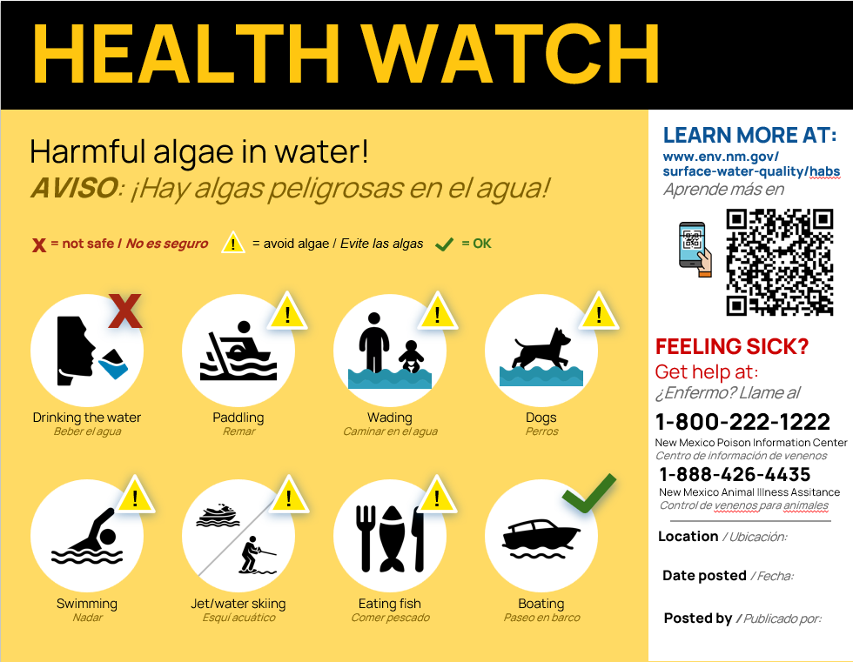
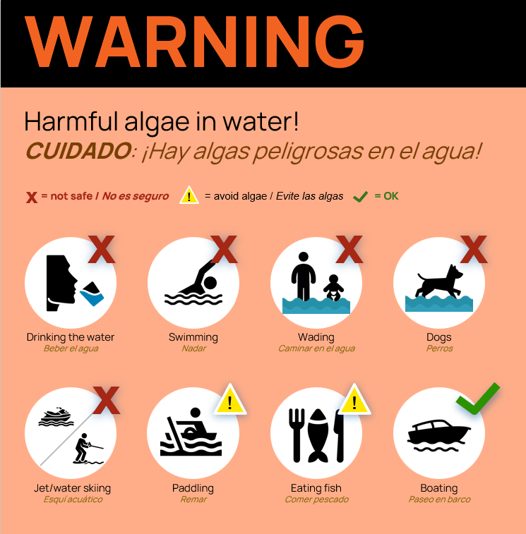
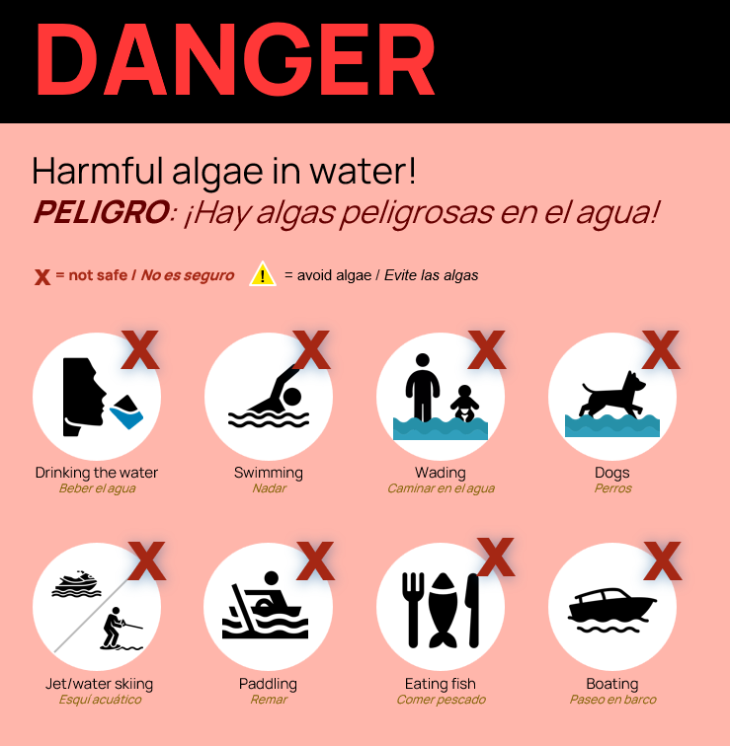
NM HABs Signage

Slide 11
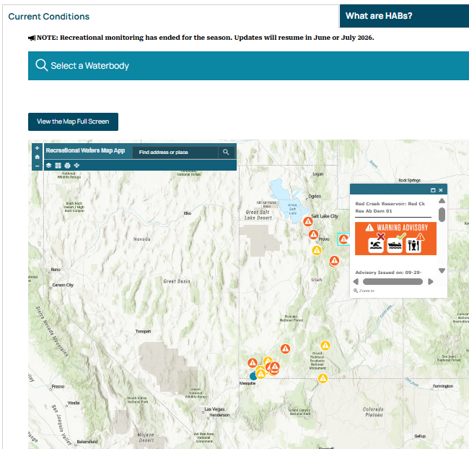
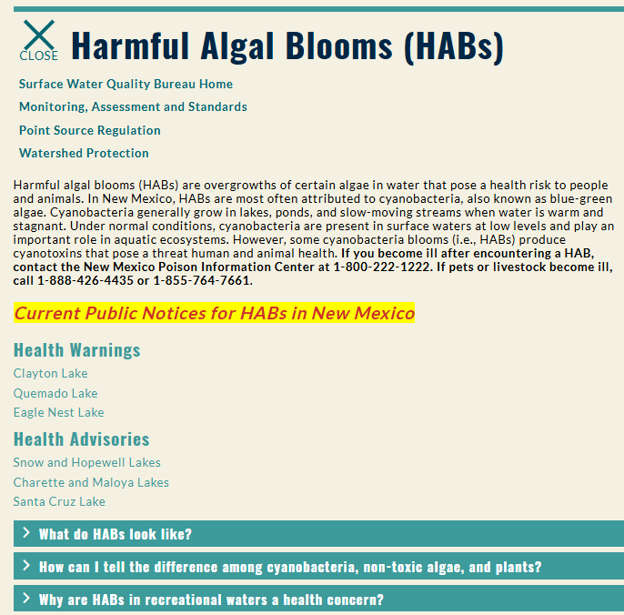
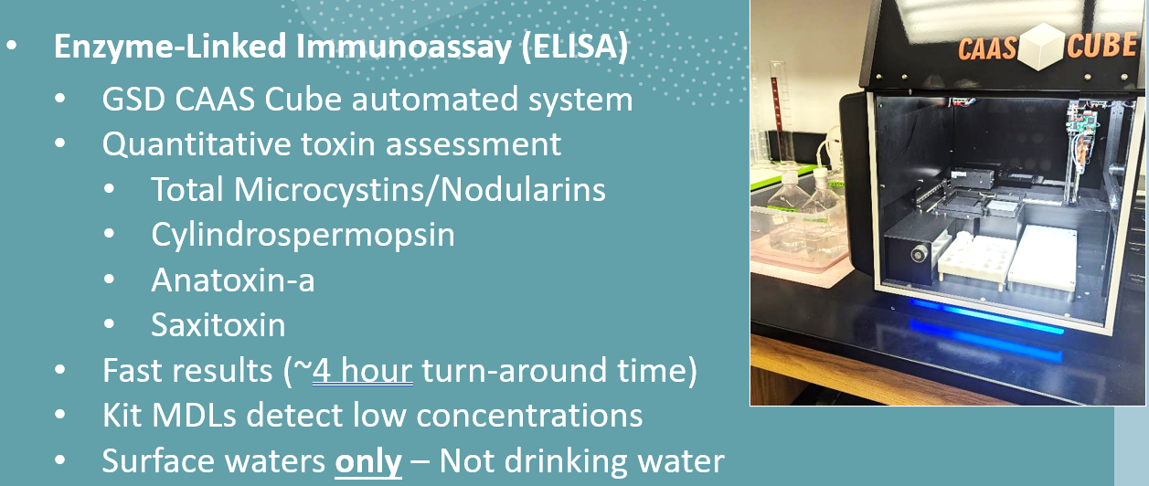
HABs Webpage and Next Steps
Notes:
NM HABs Collaborative Working Group
Establish “Report a Bloom” / Volunteer Monitoring
Shore up Sampling and Analyses Plan – incl. Sampling kits and signage for lake managers
Stand up cyanobacteria identification (microscope) and cyanotoxin (ELISA – microcystin/cylindrospermopsin/anatoxin) lab capabilities
EXPAND SWQB HABs WEBSITE:
-More user friendly
-Map of current HAB advisories and monitoring results (modeled after UT DEQ)
-NM Photo Gallery
-Report a bloom
-More resources

Slide 12
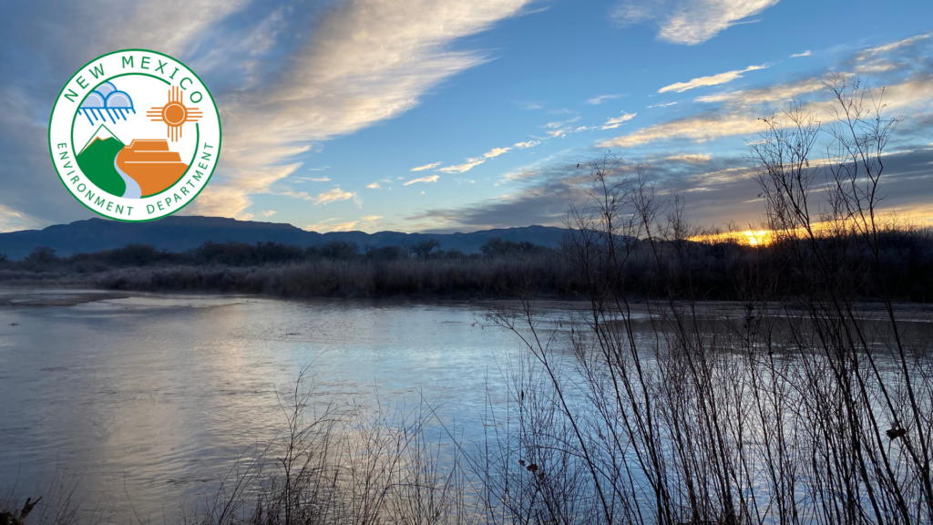
Thank you!

