Slide 1
Waste Screening at Solid Waste Facilities in New Mexico
Presented by
New Mexico Roadrunner Chapter of SWANA
Prepared in conjunction with the New Mexico Environment
Department, Solid Waste Bureau – August 2009 (Updated 2025)

Slide 2
Waste Screening
Topics covered:
Regulations and Issues
Types of Waste
Preparation for Waste Screening
Fundamentals of Waste Screening
Level of effort / Random Load Selection
Physical Examination and field testing
Managing Unacceptable Wastes
Recordkeeping

Slide 3
Lesson I - Overview of Regulations and Issues
Why screen incoming wastes?
Authority - Code of Federal Regulations (CFR) Part 258, Subpart C - RCRA - Effective Oct 9, 1993
Required by the New Mexico Solid Waste Rules: 20.9.2 -20.9.10 NMAC
Unauthorized wastes are prohibited to prevent:
  harm to the environment (potential liability)
  potential for public or employee injury
  (potential for bad publicity)

Slide 4
Transfer Station

Slide 5
Rules
New Mexico Solid Waste Rules 20.9.5.8 - General Operating
Requirements For All Solid Waste Facilities.
B. Owners and operators of a solid waste facility shall:
(1) have a certified operator or representative present at all times while the facility is operational;
(2) implement a plan approved by the secretary to inspect loads to detect and prevent the disposal of unauthorized waste, including:
(a) inspection frequency;
(b) inspection personnel;
(c) method of inspection; and
(d) a training program for the facility employees in the identification of unauthorized waste, including hazardous waste, hot waste, and PCB's;

Slide 6
Rules (continued)
(3) maintain a written operating record in compliance with 20.9.5.16 NMAC;
(4) notify the department both orally and in writing within 24 hours of an occurrence of a spill, fire, flood, explosion, mass movement of waste, or similar event;
(5) upon discovery of the receipt of unauthorized waste:
(a) notify the department, the hauler, and the generator in writing within 48 hours;
(b) restrict the area from public access and from facility personnel; and
(c) assure proper cleanup, transport and disposal of the waste;

Slide 7
Rules (continued)
(6) ensure that copies of contingency plans are readily accessible to employees on duty; and
(7) train employees when hired and at least annually
thereafter on when and how to implement contingency plans and document in the operating record that such training has been conducted.
C. The secretary may order temporary changes in operation or facility design in emergency situations when the secretary determines there is an imminent danger to public health, welfare or the environment.
D. If recyclable materials such as used oil, antifreeze, paint, or similar materials are diverted from the waste stream at a solid waste facility, the materials shall be stored for no longer than twelve months and shall be maintained in a covered area, not exposed to the weather, with secondary containment.

Slide 8
WASTE TYPES
SOLID WASTE
HAZARDOUS WASTE
CHARACTERISTIC WASTE
SUSPECT WASTE
PCB’s
SPECIAL WASTE
INFECTIOUS/
BIOMEDICAL WASTE
RADIOACTIVE WASTE
BULK LIQUIDS
HOT LOADS
CONSTRUCTION DEBRIS

Slide 9
New Mexico Solid Waste Rules state:
  load inspections will be done to detect and prevent the disposal of unauthorized waste
Waste screening will:
  reduce likelihood of future negative impacts
  reduce the severity, should contamination occur
  identify generators disposing of prohibited waste improperly
Waste Screening will not:
  eliminate risk or liability

Slide 10
Regulated hazardous wastes, PCB wastes, and other toxic materials may enter facilities in small quantities
  Consider cumulative amounts and potential impacts
  Detect by inspection of selected loads
    for example Mercury - highly toxic metal – sources include:
      some paint residues
      thermometers and thermostats
      fluorescent light bulbs
      household batteries
  When hazardous waste from a commercial or industrial source is detected, assume it is a regulated hazardous waste

Slide 11
Lesson II - Types of Wastes & Generators
Hazardous Wastes - RCRA Subtitle C
  A waste is hazardous if:
    Listed by the EPA in the CFR 40, Part 261
    Or
    Characterized as Hazardous:
        Ignitability - Flashpoint 140F, or less
        Corrosivity - pH <2 or > 12.5
        Reactivity - unstable - may explode or produce gas
        Toxicity (TCLP) - simulates leaching conditions in soils. Acid solution tested after being extracted (will identify heavy metals, pesticides, organic solvents).

Slide 12
Regulated Hazardous Waste Generators
Regulated Generators
  must receive EPA identification # via Hazardous Waste Bureau of NMED
    Large Quantity Generators
      produce GT 1000 kg (2200 lbs.) in 1 month
        approx. (5) 55 gal. steel drums
      or produces 0.02 gal (approx. 1 kg or 2.2 lbs. of acutely hazardous waste in 1 month - i.e. arsenic trioxide and copper cyanides)

Slide 13
Small Quantity Generators
  produce between 100 and 1000 kg per month
  this is 1/2 of a steel drum up to (5) - 55 gal drums (220 - 2,200 lbs.) per month
Conditionally exempt small quantity generators (CESQG’s)
  produce less than 100 kg (approximately 220 lbs. per month) of hazardous waste
  may dispose of in state permitted, subtitle D (non-hazardous ) landfill
  cannot legally place in landfill w/o consent of owner/operator - landfill has the authority to deny disposal

Slide 14
Special Wastes include:
treated formerly characterized hazardous wastes (TFCH): e.g. neutralized with acid, solidified, etc. – must be an approved EPA procedure
packing house and killing plant offal
asbestos (regulated & non-regulated)
Ash (from the incineration of solid waste at a power generating or solid waste facility-see definition in the Rules for specifics)
infectious waste
sludge, except compost meeting 40CFR 503
industrial solid waste (see definition in the Rules)
spill of chemical substance or commercial product
dry chemicals, which, when wetted, become characteristically hazardous
    example: lye
petroleum contaminated soils

Slide 15
Special wastes continued
20.9.2.7.S(13) NMAC “special waste means solid waste that has a unique handling, transportation, or disposal requirements to assure protection of the environment and the public health, welfare and safety, …”
Specific special wastes must be approved for disposal in the facility solid waste permit or they are considered an unauthorized waste.

Slide 16
A Regulated Waste:
usually state and federal programs
disposal method is prescribed by law or regulation
Examples of Federally regulated wastes:
  hazardous wastes
  PCBs
  radioactive wastes
  asbestos
Examples of State regulated wastes:
  biomedical infectious waste
  special wastes

Slide 17
Universal Waste Rule Jan. 1, 1997
What wastes are “Universal”?
  Batteries (Ni-Cad, sealed lead-acid)
  Pesticides (recalled, banned, obsolete, or just not needed)
  Thermostats/Thermometers (mercury)
  Fluorescent Light Bulbs
What are the benefits of the rule?
  streamlined notification, labeling, tracking
  extended accumulation (storage) time limits
  reduced transportation requirements

Slide 18
Lesson III - Waste Screening Preparation
pre-plan basic actions
set policy
plan carefully and thoroughly for the unexpected
arrange for alternative disposal options
Murphy’s law - Be prepared !

Slide 19
Random Waste Screening Will:
increase recognition of regulated, prohibited and unauthorized wastes by facility users & staff
Establish proper disposal mechanisms
  for refusing regulated, prohibited or unauthorized wastes
  for recognizing generators who are not disposing of waste properly
ID generators not disposing of waste properly
Establish intent of operator to follow rules requiring the screening of wastes.

Slide 20
Waste Screening Site Selection
Do not conflict with traffic patterns
Minimize weather impacts - mud, wind
Segregate screening activity - Locate nearby but not directly at the daily tipping location
Use cones or other identifying markers to signal to others that a screen is being performed.
Select loads randomly to ensure all incoming vehicles have the same chance of being selected.

Slide 21
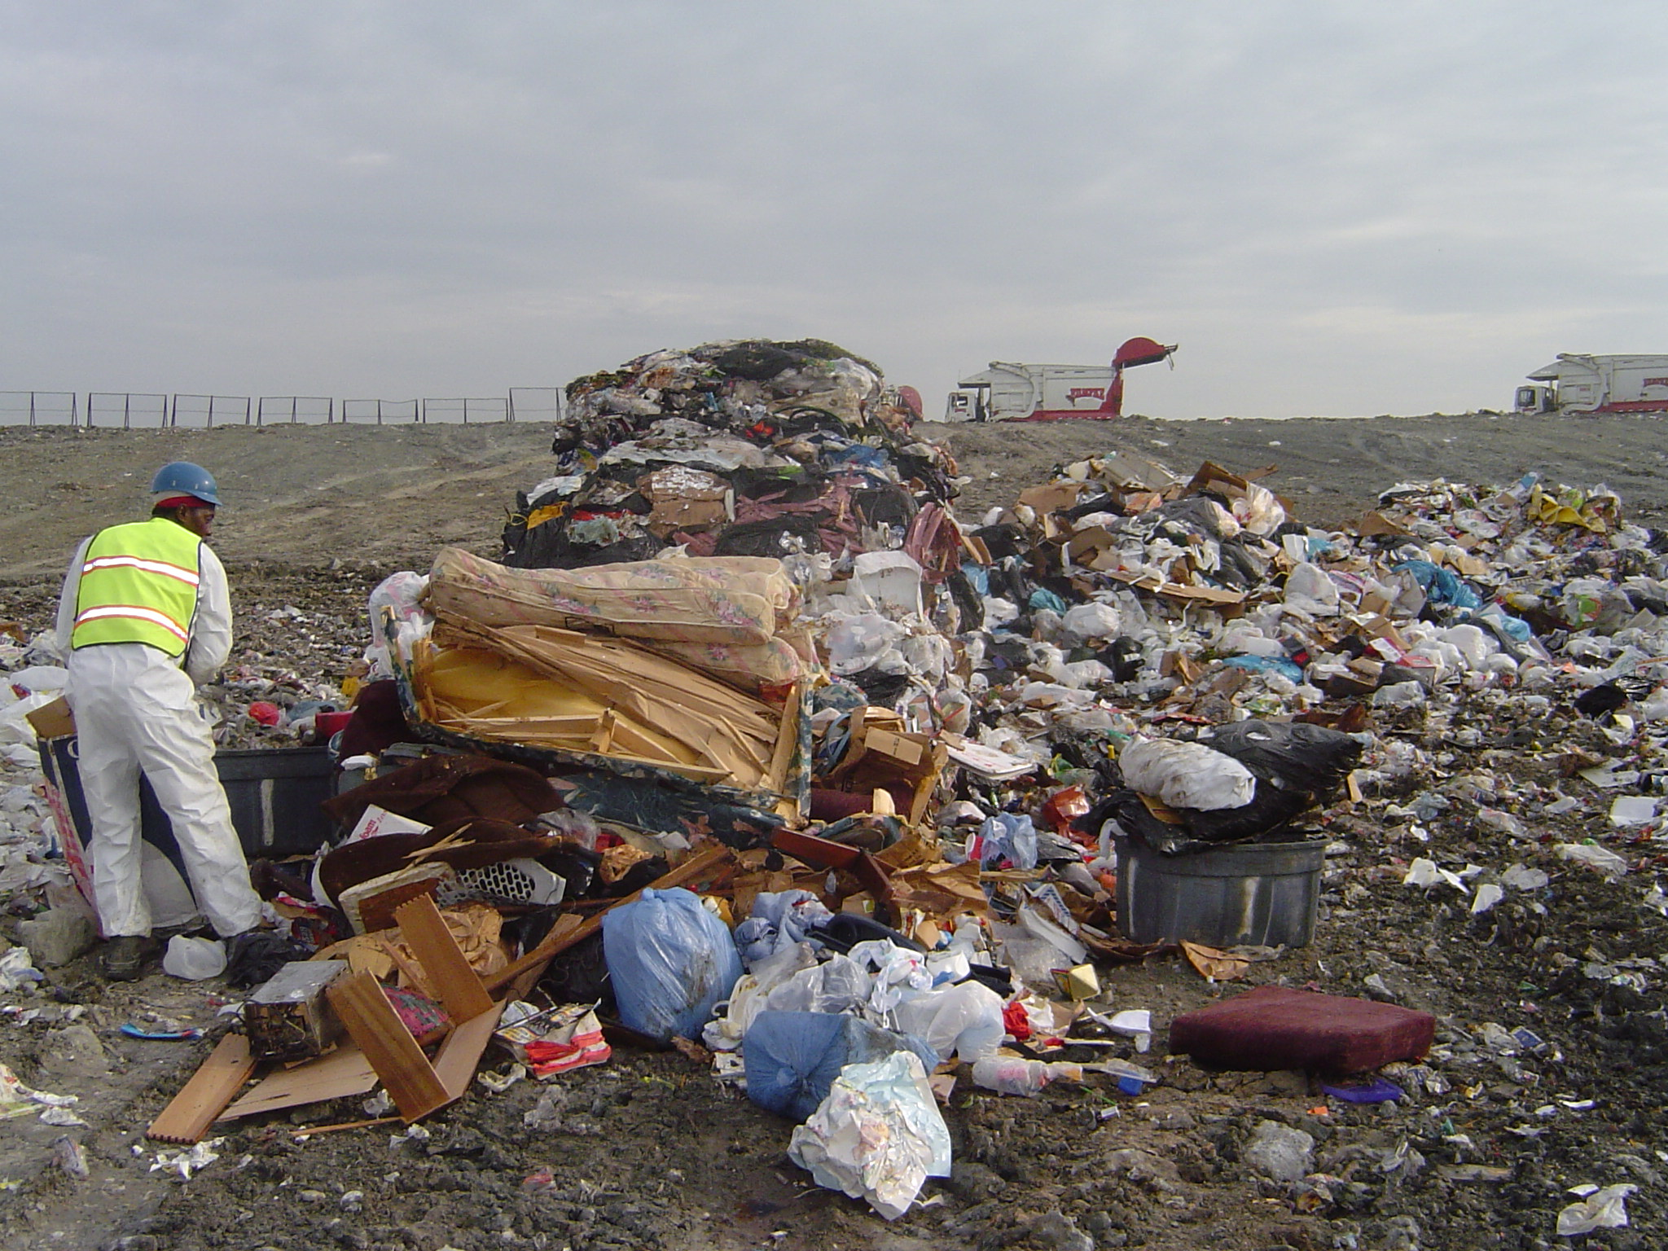

Slide 22
Waste Screening Area
Screening Pad - if possible (not frequently available at landfills)
  lined with curbs, catch basins, sloped to drain
  under drains, holding tank
  roofed, walls - possibly tire bales, fencing,
  signs excluding unauthorized persons
Employ heavy equipment to thin out loads for better visual screening and access for further investigation.

Slide 23
Lesson IV – Fundamentals of Waste Screening
Suspicious waste indicators - a review
  hazardous markings (placards, labels)
  liquids
  powders, dust, pellets, granular materials
  special waste not authorized (asbestos, ash, stained soil)
  bright or unusual colors
  containers such as 55 gal drums, or compressed gas cylinders
  “chemical odors”
  heat or smoke may indicate a “hot load”

Slide 24
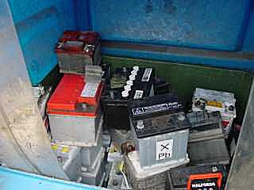


EXAMPLES - UNAUTHORIZED and PROHIBITED WASTE

Slide 25
Prohibited Waste:
Cannot be disposed of in landfill due to federal, state, or local regulation; but
Prohibited wastes include:
  radioactive
  bulk liquids
  lead-acid batteries
  used oil ,fuel
  hazardous or toxic waste & infectious waste
  non-permitted special wastes

Slide 26
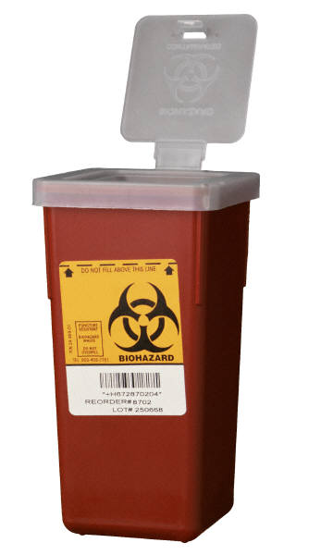
UNAUTHORIZED PROHIBITED WASTE

Slide 27

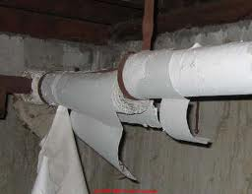

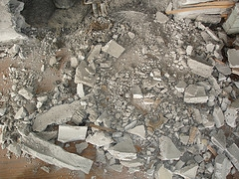
UNAUTHORIZED WASTE
EXAMPLES OF ASBESTOS CONTAINING MATERIALS

Slide 28
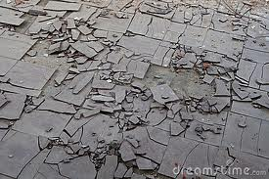
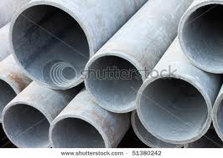
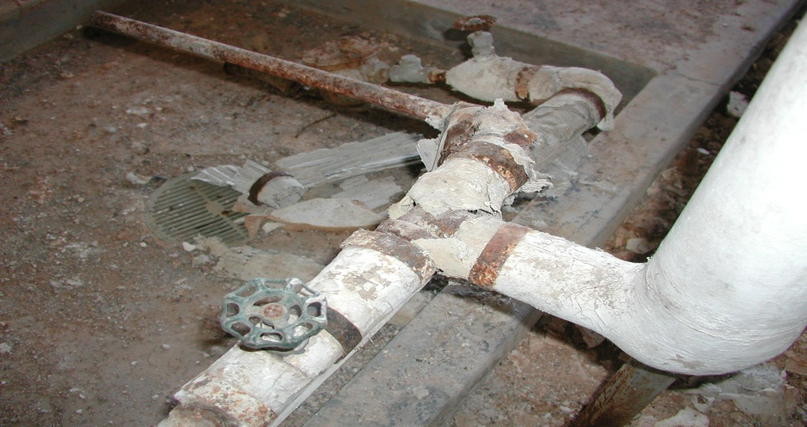
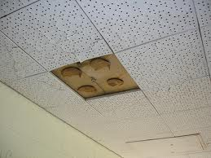
UNAUTHORIZED WASTE
EXAMPLES OF ASBESTOS CONTAINING MATERIALS

Slide 29
If you find something suspicious:
Segregate
Document and photograph (use unauthorized waste form)
question driver
review waste manifest (if used)
contact generator
use protective equipment
call response agency if necessary
notify NMED Solid Waste Bureau

Slide 30
Medical Facility/Hospital Wastes
Medical Facilities and Hospitals generate 2 types of waste
1. solid waste – general refuse
2. infectious waste – carries a probable risk of transmitting disease AND includes the following along with other items listed under 20.9.2.7.I(5):
  a. cultures of infectious agents
  b. human pathological and body fluid waste (excludes body excretions and secretions)
  c. discarded sharps

Slide 31
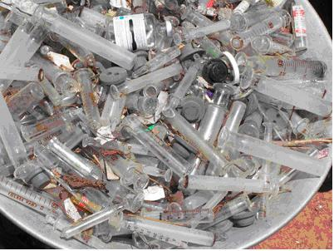

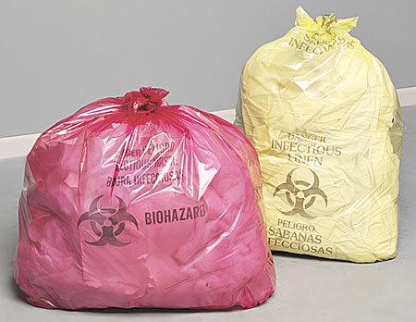
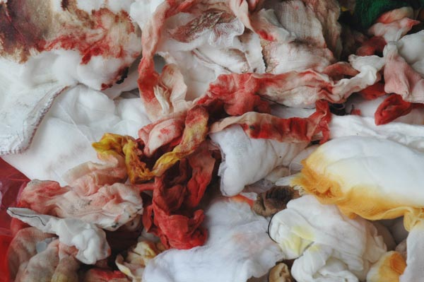
EXAMPLES OF INFECTIOUS WASTE

Slide 32
Random Load Checking
Random – use method like random number generator to choose loads for screening
Minimum Screening requirements:
  protective clothing & equipment
  tools - rakes, shovels, etc.
  procedure to segregate and thin spread waste for visual inspection
  procedure for decision making and final action
  procedure for transport or disposal if required
  decontamination, if necessary

Slide 33
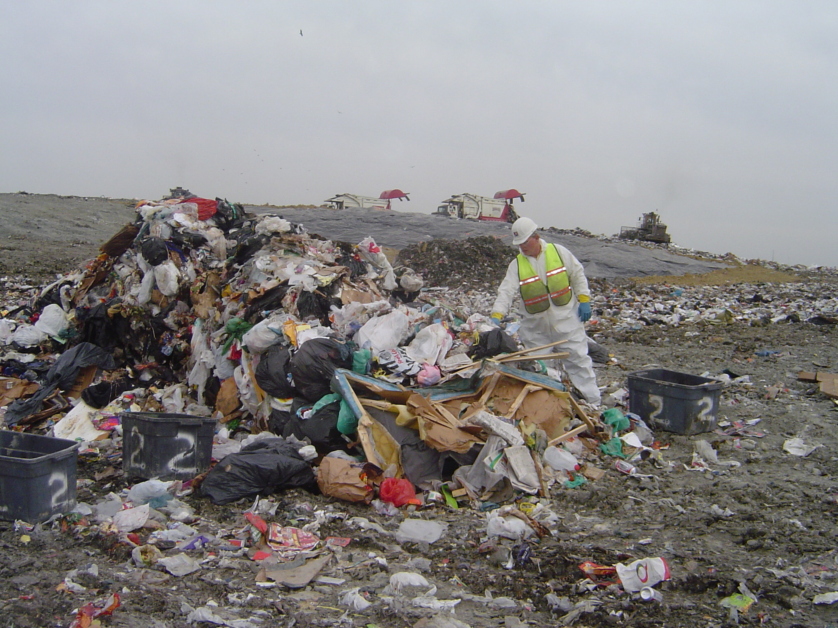

Slide 34
Regulated wastes
Liabilities of landfilling or returning waste to the hauler include:
  violation of state or federal regulations (such as hauler is not registered to haul regulated or special waste)
  may receive similar waste in the future
  may illegally dispose of it

Slide 35
Responsibility
Generator - ultimately responsible
Hauler - responsible if knowingly accepted regulated / prohibited waste
Landfill / Transfer Station / MRF
  notify hauler/generator of violation
  secure waste to keep contamination from spreading or being tampered with
  maintain necessary documentation
  contact NMED Solid Waste Bureau
  ensure proper transport & disposal of waste

Slide 36
Summary
Goal is to identify generators of unacceptable wastes
solution: close cooperation among the landfill, transfer stations, haulers and regulatory agencies
Result : proper management of wastes

Slide 37
Recordkeeping and notification requirements
Document each inspection and discovery of prohibited waste
Information to include:
  date & time of material detection
  hauler name (company & driver)
  materials detected
  generator(s) if able to identify
  actions taken
  efforts taken if hazardous material discovered
  responsible employee in charge

Slide 38
EXAMPLE WASTE SCREEN FORM
Every blank MUST be filled in. If answer is unknown or driver refuses to provide information, write “unknown” or “refused”.
UNAUTHORIZED WASTE SCREEN Date:_12/28/2017____ Time:__15:33______
Driver’s Name:_Refused – Unknown Transport Company:_Broncos Trucking Generator: Refused – Unknown
License Plate No.: __SB50-Winners________________Truck No.: _18______________Vehicle Description: ___frontloader___________
Waste Origin (location): X Albuquerque, NM □ Bernalillo County, NM □ Other: _________________________
Type of Waste (household, commercial, etc): _commercial, office waste___________________________________________
Does the Waste Contain the Following: (If yes, or waste suspect to contain the following, contact Environmental Compliance)
Screening for | Encountered? | Description | Screening for | Encountered? | Description
Barrels, drums or unusual containers, batteries, oil | X Yes, describe □ No | Compressed gas cylinder | Heat, smoke or any indication of a hot load | □ Yes, describe X No
Powder or granular materials (suspected dry chemicals) | □ Yes, describe X No |  | Hazardous, Toxic or PCB waste (markings, labels, placards) | □ Yes, describe X No
Unusual odors (sewage, dead animals, chemicals, etc) | □ Yes, describe X No |  | Infectious waste (red/ yellow bags, excluding household waste) | □ Yes, describe X No
Liquids (excluding normal household waste) | X Yes, describe □ No |  | Special waste (asbestos, stained soils, ash) | □ Yes, describe X No
Action Taken: Segregated, secured, and awaiting authorized contractor____________________________
Name of Screener: _John Doe________________________________ Signature: _John Doe_________________________

Slide 39
Public Information and Education
make them aware screening is occurring
let them know load was randomly chosen
explain regulated and prohibited wastes - what are they and why are they bad
be ready to provide information regarding where unauthorized or regulated may be disposed of properly – having handouts ready helps to prevent illegal dumping/disposal

Slide 40
Factors affecting probability of finding hazardous waste
commercial/industrial % of community
# of small quantity hazardous waste generators
level of hazardous waste regulatory effort
hauler / collector screening practices
level of public education

Slide 41
Screening Frequency
minimum : 1 vehicle per day or 1% of total vehicles per day, whichever is greater
increase frequency if unauthorized wastes are being found on a regular basis
special waste and or targeted loads: inspect these in addition to randomly chosen loads

Slide 42
Methodology for selecting loads
Random selection – unpredictable, procedure which ensures anyone can be checked at any time (use computer and random number generator to remove bias)
Process knowledge - waste from a particular industry or company might contain prohibited or hazardous waste
Suspicious loads
Targeted loads – past offenders

Slide 43
Lesson VI – Physical Examination and Field Testing
Identify types of prohibited wastes generated in your community
Identify probable sources of these wastes
Identify vehicles that collect from these sources
Conduct preliminary screening
Notify haulers of the screening program

Slide 44
Physical Examination and Field Testing
Basic Equipment
  PPE
  Shovel and three-pronged rakes
  sample containers or bags with labels
  cones or marker flags on wires
  pocket tape recorder/tapes
  camera
  watch to record times and time tests
  forms
  handouts for alternate disposal locations
  heavy equipment to thin spread when necessary

Slide 45
Protective Clothing & Equip
safety goggles
chemical resistant boots - covered/hard toes
leather or chemical resistant gloves
bright colored jacket or vest
hard hat
tyvek suit and boot covers
respiratory protection (dust mask or respirator)

Slide 46
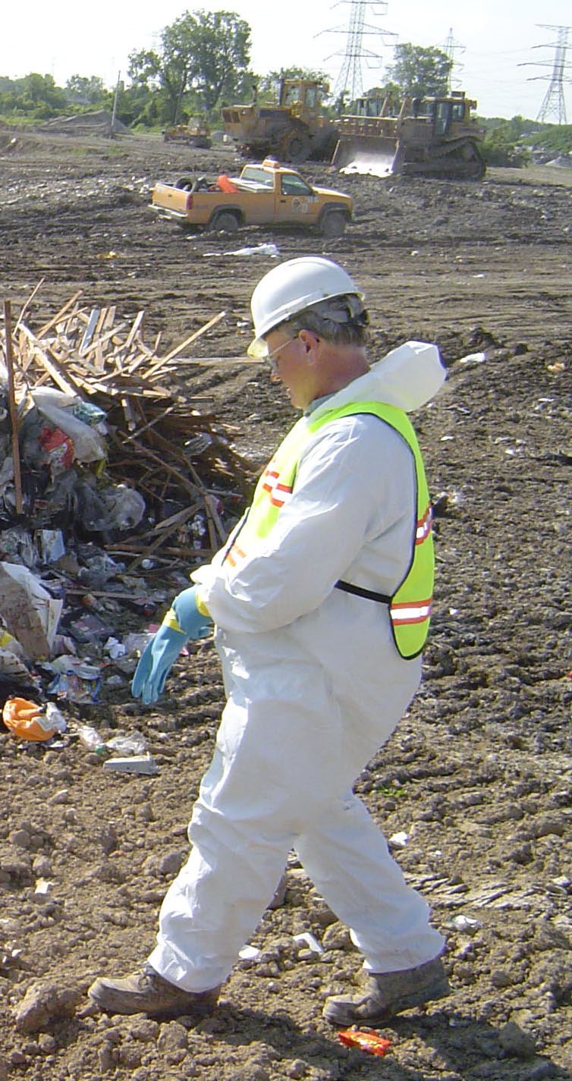

Slide 47
Recommended Personnel Requirement:
Tetanus shot
Hepatitis B virus vaccination
  screeners may receive more than incidental exposure to blood borne pathogens

Slide 48
Physical and Sensory Examination
Look - Listen - Smell
LOOK - carefully view the waste pile and individual items for anything unusual (labels, markings, containers, colors, smoke)
LISTEN – be mindful of unusual sounds -hissing, clicking, cracking, etc.
SMELL – DON’T get up close and personal to smell waste, but DO be aware of unusual smells or odors (sewage, dead animals, chemicals)

Slide 49
What do you commonly ask vehicles at the gate?
Do you have any oil, liquids, or batteries?
Where did you collect?
Did you notice anything peculiar?
Does signage clearly state what wastes are prohibited?

Slide 50
Special Items to Look for:
Transformers - suspect all for oil, although it is usually not present - do accept without oil
fluorescent light fixtures – do not accept with ballast (usually black box 3”x 9”) These could contain PCBs. Refer to local hazardous material contact
Batteries – do not accept if > household quantity
Lithium-ion batteries – fire hazard
Cathode Ray tubes - TV, computer monitors - May contain mercury. Contact computer or electronics store

Slide 51
More special items to look for:
Filters - Ask if drained, if not, refer to oil recycling area
compressors (freon) - recovery, reclamation, recycling -check if closed or open system. If CFCs recovered, tag or spray paint unit. Watch for window air conditioners and drinking fountains
mechanical equipment (capacitors)
Electrical circuit boards - usually acceptable
Red or Yellow bags - refer to generator, hospital, or med waste disp.

Slide 52
Field ID of Suspicious Liquids
Combustibility - gas explosion meter; not a match
Organic Vapor Detection - VOC meter
Corrosivity - pH paper or portable ph meter
PCBs - kits available
Reactive wastes - mostly solids, e.g. chlorine + water; ammonia+ Clorox; brake fluid + chlorine (swimming pool)

Slide 53
Test Equipment Includes:
chlorinated hydrocarbon screening kits
asbestos test kits
radiation monitors
mercury indicators
lead analysis kits
chemical test strips

Slide 54
More expensive equipment
Drager Tubes
formaldehyde meters
toxic gas monitors
hazardous gas detectors
Mercury Vapor Meters
Laboratory testing

Slide 55
Paint Filter Test (EPA Method 9095)
Ordinary filter for paint from paint store
mesh (#60) is specified in regulations for bulk free liquids
One drop in 5 minutes indicates bulk free liquid

Slide 56
Field Examination-Special Items
PCBs (if less than 50 ppm unregulated)
  transformers find out generator
  light ballasts find out generator
  have available - disposal alternative
Assume PCB containing, unless marked otherwise

Slide 57
Housekeeping
clean screening area
keep containers needed for hazardous regulated prohibited wastes, as necessary
have first aid kit available near screening area
decontamination areas for equipment and clothing may be needed

Slide 58
Records
necessary to:
  comply with legal requirements of landfill regulations
  records in the event of liability issues
  analyze program elements
    increase random screening frequency
    determine haulers consistently breaking rules

Slide 59
Lesson VII – Managing Unacceptable Waste
Facility does not want unacceptable waste
Hauler does not want unacceptable waste
Generator just wants to get rid of unacceptable waste
Compliance of generator key to success

Slide 60
If you find prohibited wastes such as lead-acid batteries
can return to hauler without violating laws
help hauler identify source
inform generator why waste cannot be accepted
If you find RCRA regulated waste:
  cannot return to hauler unless authorized to transport hazardous waste
  notify State regulatory agency
  must dispose in permitted RCRA facility administered by responsible agency

Slide 61
Haulers - Two options to address unacceptable waste
return material to hauler
dispose of the material and charge hauler later
drawbacks - returning to hauler
  proper transport and disposal not assured
  material may return
  generator is unlikely to be affected
  financially , hauler can be held responsible by 2 methods:
    facility arranges for disposal & bills hauler
    facility allows hauler to arrange & provide evidence of proper disposal

Slide 62
Organizations who may need to be notified include:
NMED Solid Waste Bureau
NMED Hazardous and Radioactive Waste Bureau
Local hazardous materials response team
Local law enforcement agency

Slide 63
Summary
Goal is to:
  identify generators of unacceptable wastes
  Keep unauthorized wastes out of solid waste facilities
Solution: close cooperation among the landfill, transfer stations, haulers, and regulatory agencies
Result :
  proper management of wastes
  protection of the environment and the public

