Slide 1
New Mexico Environment Department
Overview of Regulation of Radioactive and Hazardous Materials
James C. Kenney, Secretary
New Mexico Environment Department
May 29, 2025
Radioactive and Hazardous Materials Committee

Slide 2
Radioactive and Hazardous Materials Topics
Summary of the New Mexico Environment Department’s authorities at higher-profile facilities
Facility | Hazardous Wastes | Radioactive Wastes
Upstream oil and gas | Not regulated | Regulated
Los Alamos National Lab | Regulated | Not regulated*
Sandia National Labs | Regulated | Not regulated*
Waste Isolation Pilot Plant | Regulated | Not regulated*
Holtec CISF/Spent Nuclear Fuel | Not regulated | Not regulated
*When a radioactive waste is mixed with a hazardous waste, we call that a mixed waste, and NMED has jurisdiction over mixed wastes
Notes:
Vocabulary is important here.
Hazardous – Hazardous Waste Act
Radioactive wastes – The Radiation Protection Act. Radiation protection

Slide 3
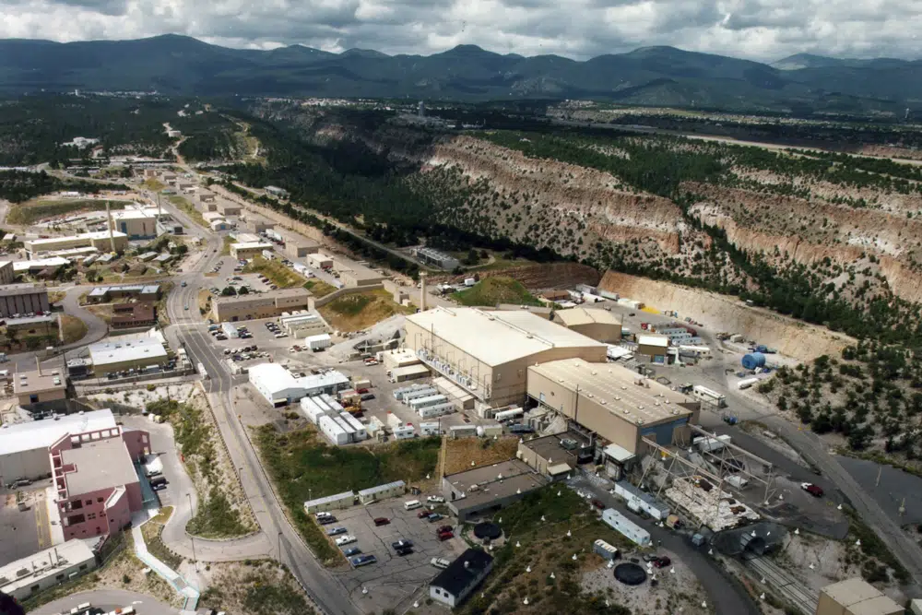
Los Alamos National Laboratory Permit Renewal
NMED reviewed LANL's permit renewal application submitted June 2020 determining it to be incomplete. Currently awaiting the revised application addressing NMED comments.
NMED approved a Class 2 Permit Modification to add storage and treatment to TA-60, which is going to be reflected on the revised application.
On Nov. 15, 2024, NMED directed DOE to address NMED comments and provide a revised renewal application by May 14, 2025.
On April 1, 2025, DOE stated the intent to include a Corrective Action Complete (CAC) petition into the renewal application.
NMED opposed inclusion of the CAC petition but allowed 60-day extension for the renewal application due to NMED by July 11, 2025.
Zoom platform
Image credit: Associated Press
Notes:
Permit Renewal is proposing to add 3 thermal treatment units (2 open detonation, 1 open burn) which were not approved in the 2010 permit application.
The permit application was missing an updated alternative technology assessment, as well as general permit information and monitoring information.
In June 2022, EPA proposed rulemaking on OB/OD includes updates to alternative technology assessment to demonstrate that OB/OD is the only available treatment for facilities, based on technology improvements
DOD working towards phasing out OB/OD entirely
DOE has submitted comments on EPA's proposed rulemaking, and is seeking an exclusion based on uniqueness of high explosive waste streams.

Slide 4
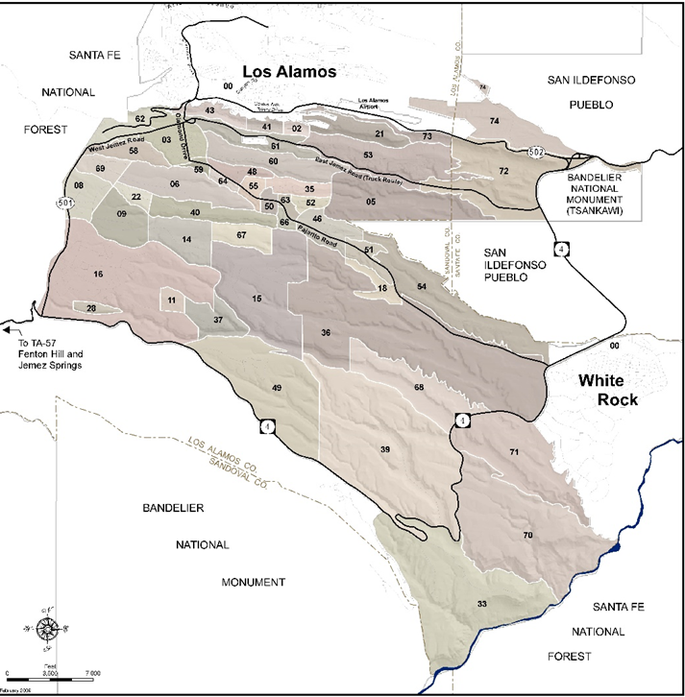
Los Alamos National Laboratory 2016 Consent Order
Compliance Order on Consent (Consent Order) was signed by NMED and DOE in June 2016.
The Consent Order requires DOE to conduct corrective action for releases of contamination from legacy sites, including contamination of groundwater at LANL.
The Consent Order is an “enforceable document” pursuant to federal and state law. With few exceptions, it is the sole mechanism for enforcing corrective action activities at LANL.
DOE and NMED did not agree on milestones for Federal Fiscal Year 2025 but is actively negotiating milestones for 2026.
Notes:
The Consent Order is an “enforceable document” pursuant to 40 C.F.R. § 264.101 and is the sole mechanism for enforcing corrective action activities at LANL, with the exception of specific conditions which are addressed under the Permit. There has been no substantive change in the status of the Complaint filed in February 2021 as the parties are engaged in settlement discussions which are privileged and confidential pursuant to Federal Rule of Evidence 408.

Slide 5
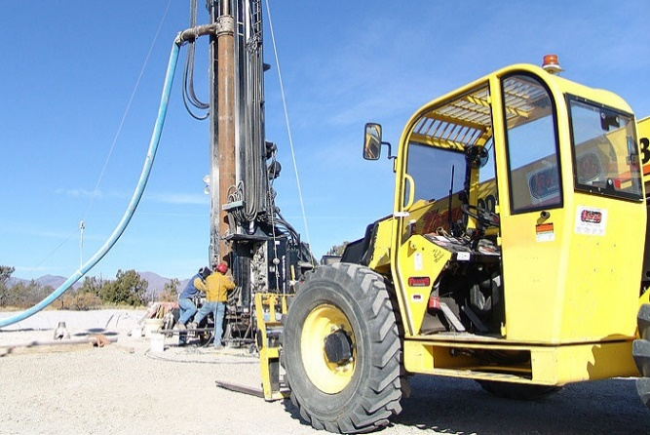
Los Alamos National Laboratory 2016 Consent Order
Example: DOE would not commit to enforceable milestones to install and monitor wells at LANL in 2020-21.
During the Annual Planning Process for federal Fiscal Year 2021, NMED and DOE could not reach consensus about substantive and appropriate milestones and targets. Subsequently, NMED and DOE participated in a Dispute Resolution process (required by the 2016 Consent Order) that ended in January 2021 without resolution.
In February 2021, NMED filed a civil complaint in First Judicial District Court of New Mexico seeking to terminate the 2016 Consent Order and negotiate new terms that expedite cleanup of legacy waste.
In March 2021, DOE moved this action to the United States District Court.
Negotiations from 2021-2024 resulted in a Settlement Agreement that includes a revised Consent Order, NMED agreement to complete review of COC requests, and a $333,000 remittance to NMED
Modified Consent Order expands both NMED and DOE accountability, revises the ineffective dispute resolution procedures, restructures campaign classification and organization, and increases public participation.
Notes:
Current Status
February 24, 2021, NMED filed a civil complaint against DOE to speed clean-up of legacy waste at LANL;
Specifically, NMED objects to the slow pace of progress by DOE regarding the 2016 Consent Order requiring DOE to clean up legacy waste at LANL;
NMED has attempted to resolve issues through the mandated dispute resolution process; however, parties were unable to agree on a plan; this process ended January 2021;
NMED seeks the Court to terminate the 2016 Consent Order, to order the parties to enter into court-supervised negotiations to negotiate the terms of a new Consent Order to achieve the cleanup completion date of 2036, and to include specific mechanisms to ensure DOE’s compliance with future work and annual planning commitments.
The case was removed by DOE from State District Court to Federal District Court shortly after it was filed.
One additional topic of note that could come up is a proposed Tritium venting release by LANL that has been mentioned in the past by members of the public. To date, NMED has not received a formal notice from LANL and in conversations with LANL and DOE personnel, this is not imminent.

Slide 6
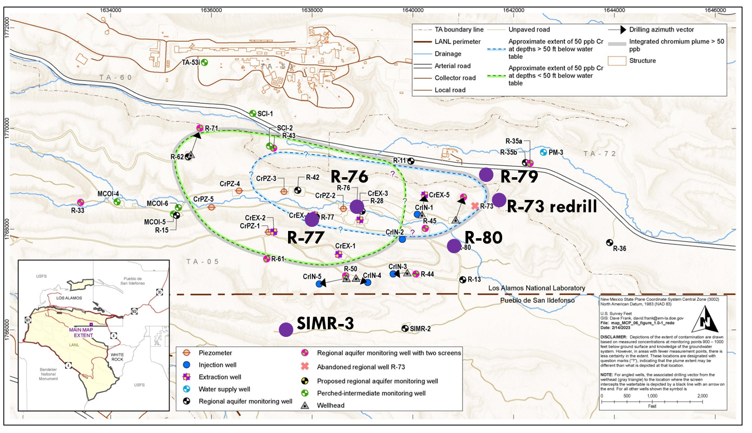
Los Alamos National Laboratory Hexavalent Chromium Interim Measure Update
Following the recommendations of this Committee, NMED and DOE participated in an expert, independent, technical review team (IRT) of the hexavalent chromium project. The goal was to reach resolution on the impasse caused by differing technical opinions.
After six months of review and analysis, the IRT supported many of NMED's regulatory requirements.
IRT Recommendations
Supported the restart of interim measures in a limited capacity with partial, but strategic approach.
Recommended expanding the interim measures pump-and-treat system with alternative high-volume capacity injection well.
Supported conversion of groundwater model to MODFLOW code.
NMED is negotiating inclusion of these recommendations into the revised Interim Measures Plan.
Proposed Future Monitoring Wells
Notes:
Hexavalent Chromium plume discovered in a regional aquifer in 2005 at LANL
Plume is 1 mile long/half mile wide. Thickness is uncertain
NMED regulates chromium in groundwater at 50 ppb. TBD
Interim Measures implemented in mid-2018 along Pueblo de San Ildefonso boundary
NMED is requiring re-evaluation of the Interim Measure-assumptions not valid
NMED requires additional regional wells to define the vertical extent of the plume

Slide 7
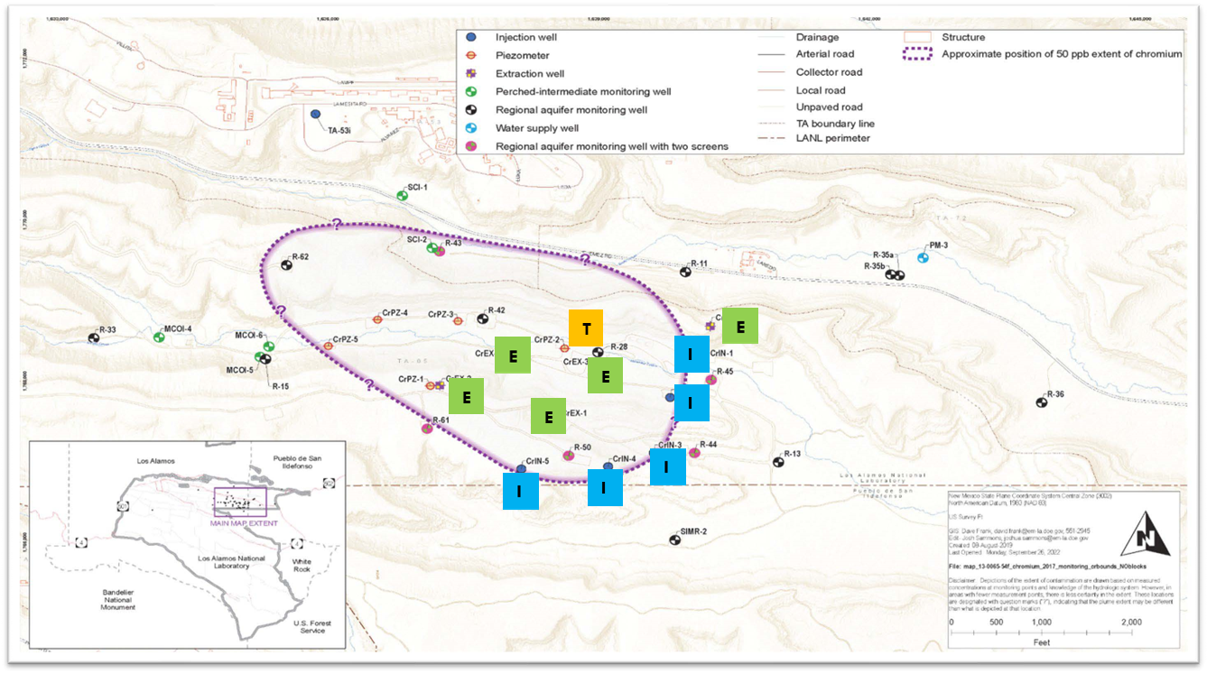
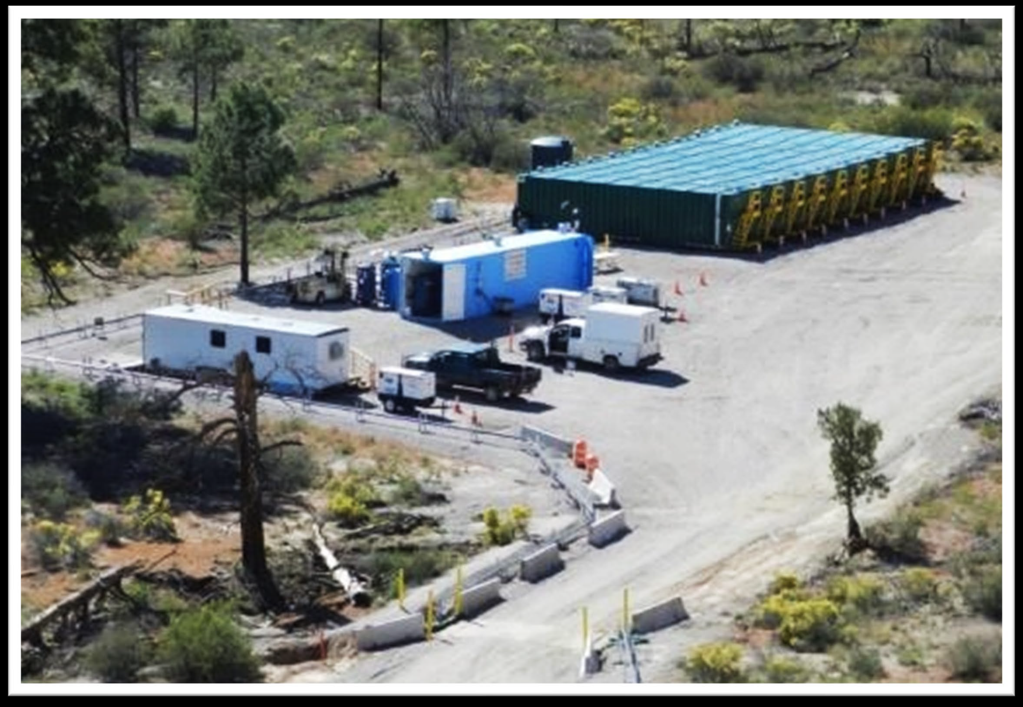
Los Alamos National Laboratory Incorporating Independent Technical Review Recommendations
Magnitude and complexity of the key recommendations requires further discussion with DOE on implementation and prioritization
HWB is negotiating to determine a deadline on the revised Interim Measure Work Plan
Revision will need to include a proposal for an expansion of the interim measures system
Must satisfy the disapproval comments and include a plan to incorporate recommendations
GWQB is requiring the corrective actions proposed by DOE in response to the non-compliance with the discharge permit conditions
Installing groundwater monitoring wells R-79 and R-80 to evaluate downgradient impacts from injection
NMED is negotiating the Consent Order annual planning in Appendix B for Fiscal Year 2026
Due by July 31, 2025
Notes:
Current Status
NMED asked for a Solid Waste Management Unit (SWMU) Assessment Work Plan;
SWMU Assessment Work Plan was approved by NMED March 2021;
Field work started April 2021;
SWMU Assessment Report due to NMED April 2022;
DOE provides NMED with regular updates on progress;
DOE and NMED-DOE-OB are monitoring air quality;
Stormwater Run-on and Run-off are controlled by DOE.

Slide 8
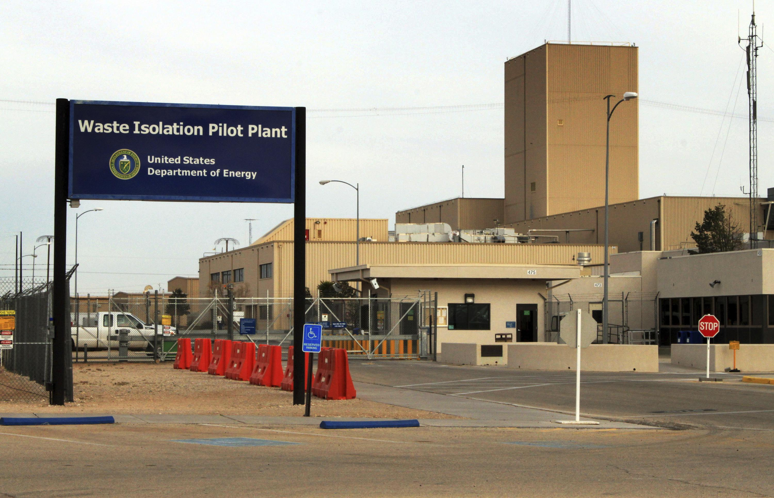
Waste Isolation Pilot Plant - Operating Permit
NMED has been focused on ensuring compliance with new renewal permit conditions over the past year and a half including:
The Legacy TRU Waste Disposal Plan – NMED requested an updated Plan to be submitted Nov. 17, 2025.
The Annual Repository Siting Report – NMED is in the process of drafting recommendations for improvements to future submittals.
WIPP Community Forums – Three held in 2024 per the new permit condition; the first of three for 2025 was held in Carlsbad on Apr. 30.
2024 & 2025 certifications have been received demonstrating sufficient capacity for NM generator/storage site waste in the WIPP underground.
Zoom platform
Image credit: Associated Press News
More information can be found on the HWB WIPP News webpage:
https://www.env.nm.gov/hazardous-waste/wipp/
Spanish interpretation options

Slide 9
Emerging Contaminants: PFAS
Safe Drinking Water Act
CERCLA/RCRA
Regulate as individual contaminants:
PFOA, PFOS
MCL = 4.0 ppt
PFNA, PFHxS, HFPO-DA (GenX)
MCL = 10 ppt
EPA will re-evaluate Fall 2025
Regulate as a mixture:
PFNA, PFBS, PFHxS, and HFPO-DA (GenX)
At least 2 must be present
Hazard Index MCL = 1.0 (unitless)
EPA will re-evaluate Fall 2025
CERCLA
On April 19, 2024, the EPA issued Final Rule designating PFOA and PFOS as CERCLA Hazardous Substances.
RCRA
NM-led efforts to have the EPA include PFAS/PFOS as hazardous constituents and wastes resulted in the EPA proposing two rules that list nine PFAS / PFOS in the "Appendix VIII" hazardous constituents list and clarify a state's authority over these contaminants in corrective action activities.
Notes:
February 28, 2024: EPA released TWO proposed regulations (89 Fed. Reg. 8606 (Feb. 28, 2024); 40 C.F.R. pts. 261 and 271; https://www.epa.gov/newsreleases/biden-harris-administration-announces-new-steps-protect-communities-pfas-and-other): 1. Add 9 PFAS to the list of Hazardous Constituents 2. Assure that EPA’s regs reflect EPA’s and authorized states’ authority to require cleanup of the full range of substances that RCRA intended
June 3, 2021 - the Governor petitioned EPA and requested it list PFAS as a class of chemicals within Subpart C of RCRA, or in the alternative, list individual PFAS chemicals under RCRA. October 26, 2021 - EPA responded with information on the two forthcoming rulemakings that were then proposed on February 28, 2024

Slide 10
Kirtland Air Force Base Bulk Fuels Facility Spill
Current Status
NMED approved the revised Soil Vapor Monitoring Plan in January 2024; sampling is occurring now under the new plan.
Risk assessment will be updated with additional data.
Phase II RCRA Facility Investigation has been submitted and is currently under NMED review. Upon approval, KAFB to proceed towards Corrective Remedy Evaluation and Corrective Remedy Selection.
Path Forward
NMED is working with a third-party contractor to review the submitted monitoring reports and other documents, and to evaluate all past data to determine if sufficient information is available to proceed to the Corrective Measure Evaluation Phase.
NMED is communicating frequently with KAFB to identify data gaps and resolve issues to move toward a final remedy selection.
NMED and the Air Force are collaborating to improve stakeholder engagement and public confidence in our shared ability to safeguard our community.

Slide 11
Neglected Contaminate Sites and Abandoned Uranium Mine Cleanup
HB2 included $20,000,000 to clean up contaminated sites across the state
Abandoned Uranium Mines
$12,000,000 for cleanups at Moe #4, Schmidt Decline, and Red Bluff #1, preliminary work on 20 additional sites, cost of assessments by EMNRD under Mining Act Reclamation Program.
Neglected Sites
$8,000,000 for cleanups of Tucumcari Truck Stop and the Aerex Refinery near Bloomfield.
$2,000,000 for 24 state-lead petroleum storage tank sites corrective action.

Slide 12
2025 NMED Legislative Summary
HB 140 - AFFF Defined as Hazardous Waste
HB 212 - Non-Essential PFAS Ban
HB 291 – RAID Act Amendments and Circular Economy
SB 21 – Established authority for NMED to permit surface water discharges under federal law and filled gaps in surface and ground water protection, including neglected contaminated sites

Slide 13
Thank you!
13

