Slide 1
New Mexico Environment Department
2020 Minor Source Emissions Inventory Roslyn Higgin,
Emissions Inventory Specialist
May 20, 2020

Slide 2
AGENDA
What is an Emissions Inventory?
Actual vs. Permitted Emissions
Purpose of an Emissions Inventory
Preparing for the Minor Source Emissions Inventory
Log sheets
Air Emissions Inventory Reporting (AEIR)
Calculation of Actual Emissions
Questions
Notes:
We will begin with a few definitions about emissions inventory

Slide 3
What is an Emission Inventory?
Emission Inventory is an accounting, by source, of the amount of air pollutants discharged into the atmosphere.
Regulatory Authority for AQB to request an emissions inventory:
Notice of Intent and Emissions Inventory Requirements - 20.2.73 NMAC
Notes:
Emissions Inventory is a collection of the amount of emissions release into the atmosphere over a year.
What gives AQB the authority to collect emissions is 20.2.73 New Mexico Administrative Code (NMAC)
Part 73 of the NMAC requires AQB to inventory major sources annually and gives the authority to inventory minor sources no more than annually.
Notice of Intent and Emissions Inventory Requirements 20.2.73 NMAC
Part 73 requires AQB to inventory major sources annually and gives us authority to inventory minor sources no more than annually.

Slide 4
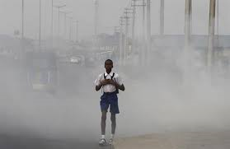
What is the purpose of Emissions Inventory?
The purpose of the inventory is to quantify pollutant emissions to assist in:
  modeling analyses
  human health risk assessment studies
  emissions trends
  developing control strategies
  assessing the effectiveness of air pollution policies
Notes:
The Emission Inventory Section (EI) collects and examines amounts of emissions from various sources in New Mexico to facilitate planning and modeling of these emissions. The data for major sources is submitted to the Environmental Protection Agency (EPA) Emissions Inventory on a yearly basis.

Slide 5

Actual vs. Permitted Emissions
Actual Emissions are NOT Permitted
or Allowable Emissions
YOU MUST USE ACTUAL EMISSIONS FOR YOUR EMISSIONS INVENTORY
Actual emissions are the emissions of a pollutant that are released from a source.
Permitted emissions are the emissions
calculated based an estimated production listed
in your permit or application.
Notes:
Actual emission are the real emissions emitted into the atmosphere in the past year.
Actual emissions include routine or steady state activities, startup, shutdown, and maintenance activities, malfunctions (for any reason) and excess emissions.
In other words, actual emissions includes any and all activities that cause pollutants to be emitted into the atmosphere.
Actual emissions are NOT permitted or allowable emissions listed on your permit.
Permitted or allowable emissions in your permit were based on estimated facility production or equipment throughput.

Slide 6
Calendar Year 2020 - Keep Records
Keep records of the following to calculate actual emissions. Use the construction industry guidance documents for equipment and record keeping items.
  Aggregate
  Asphalt
  Concrete
https://www.env.nm.gov/air-quality/ei-minor-sources/
Notes:
It is important that you keep records of the:
actual operating hours for each piece of equipment that emits actual emissions
record the daily hourly use for each piece of equipment included in the inventory.
production or facility production – For example, how many barrels of oil were produced at the end of line or total facility output on a daily basis.
fuel combusted – refers to the type and amount of natural gas or other fuel was combusted per piece of equipment.
material processed – For example, a crusher is crushing gravel and the materials processed is gravel. The amount of ore crushed is required and the number of actual hours operated.

Slide 7
GCP Recordkeeping and Log Sheets
Log Sheets for recordkeeping
The following link has the documents viewed in the presentation:
https://www.env.nm.gov/air-quality/frequently-requested-forms/

Slide 8
Pollutants to be included
Criteria pollutants required to be reported:
  Carbon Monoxide (CO)
  Sulfur Dioxide (SO₂)
  Particulate Matter (PM_{2.5}) less than 2.5 microns
  Particulate Matter (PM₁₀) less than 10 microns
  Nitrogen Oxides (NO_{x})
  Lead (Pb)
Volatile Organic Compounds (VOC)
Hazardous Air Pollutants (HAPS)
Notes:
This is a list of all the pollutants that the Emissions Inventory Section collects. Your facility may not require all criteria pollutants—refer to your permit.
The 3 greenhouse gases are included in the emissions inventory.
VOCs include methane and HAPS.
With your calculations, include a copy of a gas analysis – a representative gas analysis will be fine.

Slide 9
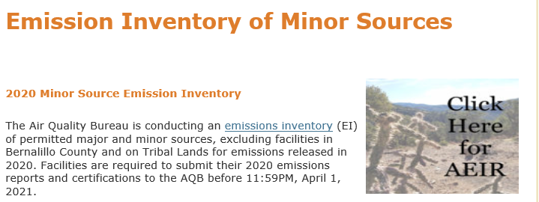
Accessing Air Emissions Inventory Reporting Web-based Tool (AEIR)
Notes:
This page can be accessed through the NMED – AQB link.

Slide 10
AEIR Review
Minor source facilities will be ready for your review through AEIR by September 2020.
Once you gain access, review each of your facilities’ information. For example, equipment may or may not be listed.
The ‘Add Equipment’ option will enable certain types of permits (GCPs 2, 3, 5 and NOIs) to enter all equipment.
Notes:
Clarify access. CSI NM should be working by then, if not then ESAA forms must be used.

Slide 11
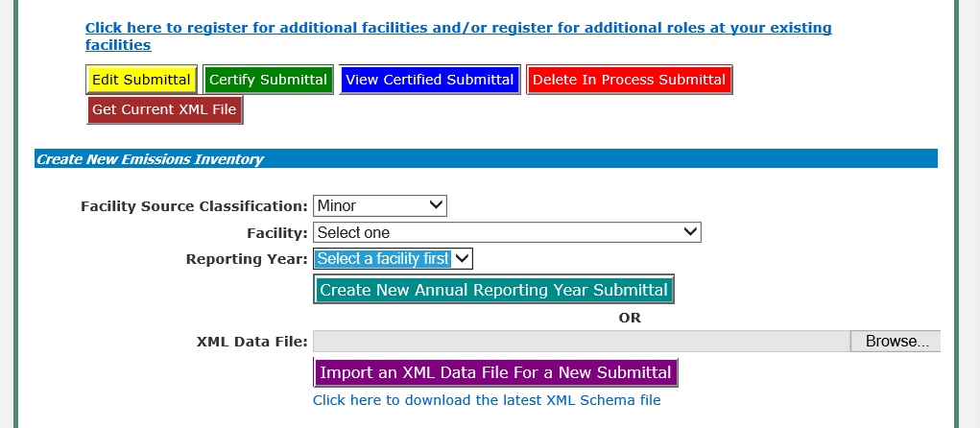
Create New Emissions Inventory Report
Notes:
Here you can create a new emissions inventory report.

Slide 12
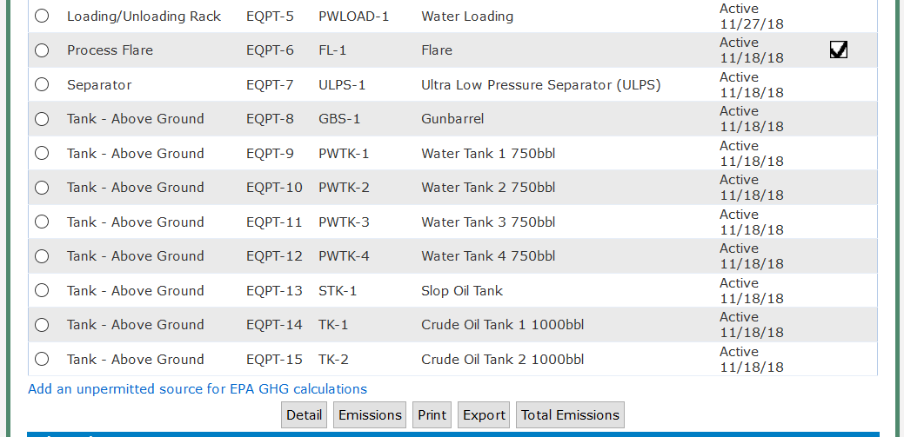
Air Emissions Inventory Reporting (AEIR) Overview
NOIs & GCPs
Add Equipment
Notes:
When you open AEIR and select your facility, a list of equipment for that facility will appear.
AEIR pulls pieces of permitted equipment and pollutants from your permit.
The first column is type of equipment, then the ID number that our database gives it, the third column
Is the designation or the name of the equipment given by the facility and a description.
The fifth column states the date the piece of equipment became active.
The last column with the box and the check indicates that the emissions information is complete for that piece of equipment.
To select a piece of equipment, simply click on the radio button to the far left and click on detail at the bottom of the page.

Slide 13
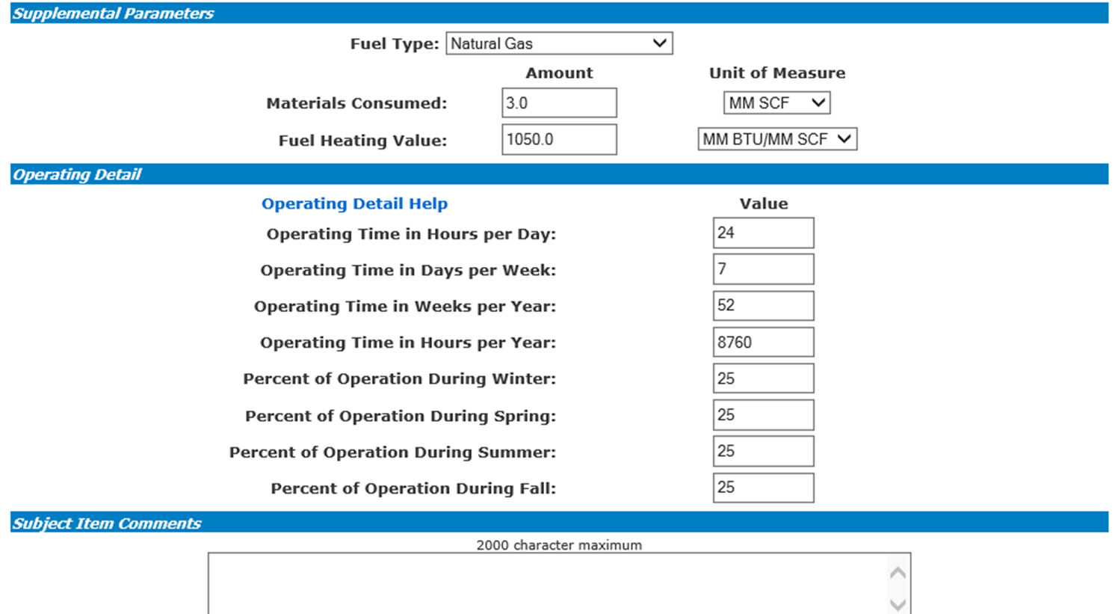
Subject Item Detail Form
Notes:
This bring you to the subject item detail page where fuel type, materials consumed, and fuel heating values all have drop down menus.
Under Operating detail, enter the operating detail information as shown. This piece of equipment is a flare and ran 24/7 which equals 8760 hours.
There is a comment box on that bottom for any comments you would like to add about this equipment.
Then SAVE.

Slide 14
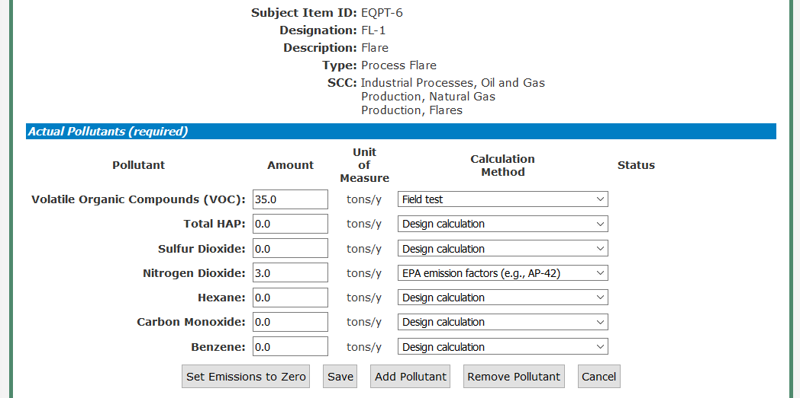
Emissions for Subject Item
Notes:
The second form is where the actual emissions are entered.
The list of pollutants appears or pollutants can be added or removed according to the gas analysis and calculations.
For each pollutant, a calculation method must be selected. It too provides a drop down method.
All pollutant amounts are entered in tons per year.

Slide 15
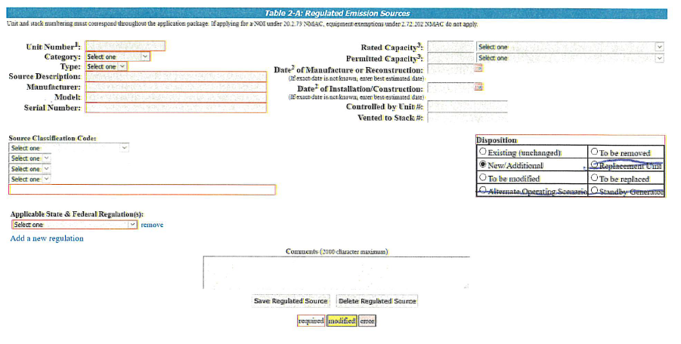
Add Equipment

Slide 16
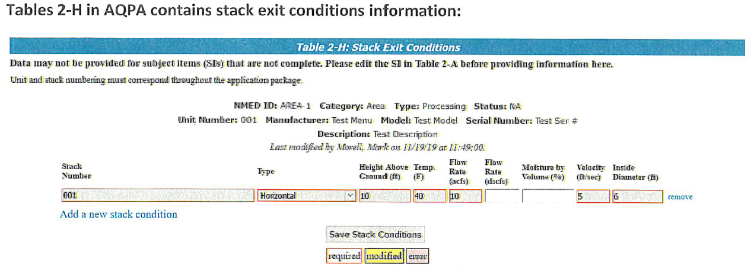
Add Equipment – Stack Data

Slide 17
Calculation of Actual Emissions
Several ways to calculate actual emissions. Below are two methods:
  EPA’s AP-42 Link: https://www.epa.gov/air-emissions-factors-and-quantification/ap-42-compilation-air-emissions-factors#Proposed/
  AQB’s Calculation Tool (example by Eric)

Slide 18
Contact
Roslyn Higgin
Emissions Inventory Specialist
Roslyn.Higgin@state.nm.us
505-476-4319
Rhonda Romero
Minor Source Permitting Manager
Rhonda.Romero@state.nm.us
505-476-4354
Sufi Mustafa
Air Dispersion Modeling/Emissions Inventory Section Manager
Sufi.Mustafa@state.nm.us
505-476-4318
Link: https://www.env.nm.gov/air-quality/ei-minor-sources/
Our mission is to protect the inhabitants and natural beauty of New Mexico by preventing the deterioration of air quality.
Notes:
We understand that many of the permits and registered facilities may be ‘old’ and pieces of equipment have changed.
If this is the case for your facility, then it is not too late to contact permitting and update your permit or registration as soon as possible.

