Slide 1
New Mexico Environment Department
Opportunities Offered by the CPRG
(Climate Pollution Reduction Grant)
2024-01-03
Amy Rosebrough
Environmental Scientist
Climate Change Bureau
amy.rosebrough@env.nm.gov
505-629-5559
&
kolt.vaughn@env.nm.gov
505-819-8205
Notes:
Kolt or Amy
Greetings, everyone. I hope you and your loved ones are in good health. Thank you for taking the time to meet with us today.
----------
INTROS ::::: Presenters, then depts.’ staff.
----------
The topic we are here to discuss is the Opportunities Offered by the Climate Pollution Reduction Grant
First, let me start be saying that Amy and I are new to NMED. And, we recognize that we are working for a state agency that you all may or may not have disagreements with on various topics. We acknowledge that is the case, but if I may, please know that we want and hope to work collaboratively with you all on this project. We also expect your feedback to shape this process and the outcomes, so please express your support or concerns for the discussion today and moving forward. Lastly, we intend to be open and transparent with you all throughout this process, so if you have questions – even if they are really hard questions – please don’t hesitate to ask.

Slide 2
CPRG Overview
EPA-funded grant program through the Inflation Reduction Act (IRA).
Two main goals of the grant:
To reduce greenhouse gas emissions.
To benefit local communities, especially Low Income & Disadvantaged Communities (LIDAC),* by creating high-quality jobs, improving health, and keeping families safe.
* “LIDAC” is the term used by the federal government in their CPRG Notice of Funding Opportunities (NOFOs). Federal LIDAC language can be found in CPRG Planning Guidance and CPRG Implementation NOFO. The State recognizes that this term may not reflect its communities.
Notes:
Acknowledge that some Tribes are very familiar with this grant and were awarded the Phase 1 funds.
In June 2023, the United States Environmental Protection Agency (US EPA) awarded the State of New Mexico the Climate Pollution Reduction Grant (CPRG). The CPRG supports the State in creating a Climate Action Plan for implementing effective greenhouse gas reduction strategies, while ensuring the benefits of these strategies are seen in disadvantaged communities. This grant will give New Mexican communities the opportunity to collaborate with the State to build projects in their communities that provide high-quality jobs, improve health, and keep families safe.
The development of the Climate Action Plan will be jointly led by the Interagency Climate Change Task Force (CCTF), which is composed of representatives from the New Mexico Environment Department (NMED) and Energy, Mineral, and Natural Resources Department (EMNRD). To make this plan reflective of New Mexico's unique values, culture, and priorities, the CCTF will collaborate with communities, municipal governments, tribal governments, businesses, educators, utility operators, and more. Potential benefits of the CPRG money within New Mexican communities are training and workforce development opportunities, clean energy and energy efficiency development, clean transit, and much more.

Slide 3
Two Phases of CPRG
Phase 1: Planning Grant
Priority Climate Action Plan (PCAP)
+ due March 1 (state & MSA)
Comprehensive Climate Action Plan (CCAP)
+ due Summer/Fall 2025
Status Report
+ due Summer/Fall 2027
+ required: updates on all PCAP & CCAP items with next steps
DELIVERABLES
Phase 2: Implementation
Award:
$4.6 Billion Total
$2-500 Million Awards
Due Date:
April 1, 2024
Eligibility:
State, Municipality (or MPO), or Tribe.
Measure covered by State PCAP
Purpose:
Reduce GHG Emissions
Provide benefits to LIDAC’s
Fill funding gaps
DETAILS

Slide 4
Climate Pollution Status
NM greenhouse gas emissions by sector (2018).
NM produced approximately 113.6 million metric tons (MMT) of GHG emissions.
http://tinyurl.com/mtt325ma
Notes:
Kolt – Total emissions = (2018)
http://tinyurl.com/mtt325ma

Slide 5
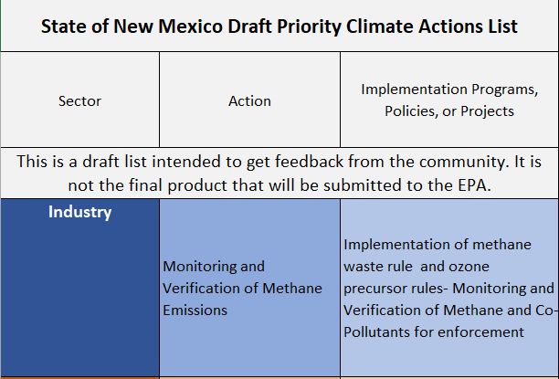
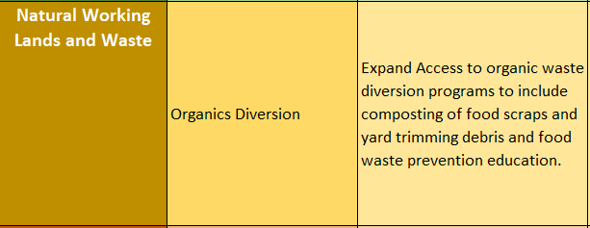
Input on Draft Priority Climate Action List
Not an exhaustive list, but rather priority actions that fit within the CPRG context and timeline.
Will evolve as the state gains more information and community feedback on:
Emissions Reductions Potential
Community benefits and disbenefits
Implementation feasibility and timeline
Gaps in current funding.
...
...

Slide 6
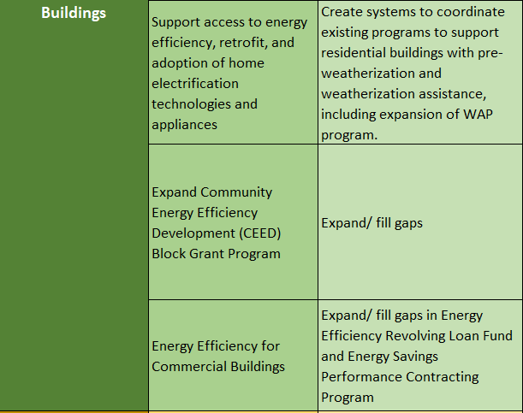
Input on Draft Priority Climate Action List
Not an exhaustive list, but rather priority actions that fit within the CPRG context and timeline.
Will evolve as the state gains more information and community feedback on:
Emissions Reductions Potential
Community benefits and disbenefits
Implementation feasibility and timeline
Gaps in current funding.

Slide 7
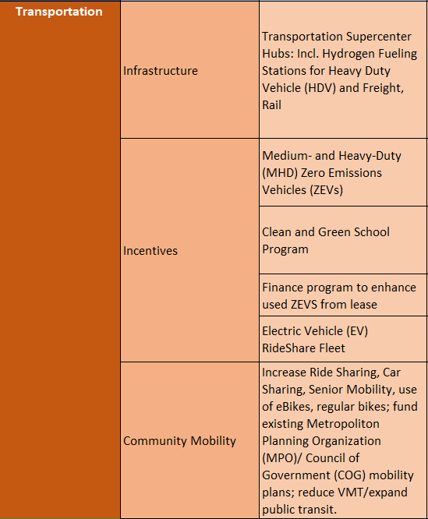
Input on Draft Priority Climate Action List
Not an exhaustive list, but rather priority actions that fit within the CPRG context and timeline.
Will evolve as the state gains more information and community feedback on:
Emissions Reductions Potential
Community benefits and disbenefits
Implementation feasibility and timeline
Gaps in current funding.
Not an exhaustive list, but rather priority actions that fit within the CPRG context and timeline.
Will evolve as the state gains more information and community feedback on:
Emissions Reductions Potential
Community benefits and disbenefits
Implementation feasibility and timeline

Slide 8
MPO Funding Opportunities
MPO’s can apply for Phase 2 (implementation) grants if the proposed measures are covered in an applicable PCAP:
Entities with applicable PCAPs:
NMED,
CABQ (If located in ABQ MSA area)
Propose projects within our priority list to include in State application.
Notes:
Acknowledge that some Tribes are very familiar with this grant and were awarded the Phase 1 funds.
In June 2023, the United States Environmental Protection Agency (US EPA) awarded the State of New Mexico the Climate Pollution Reduction Grant (CPRG). The CPRG supports the State in creating a Climate Action Plan for implementing effective greenhouse gas reduction strategies, while ensuring the benefits of these strategies are seen in disadvantaged communities. This grant will give New Mexican communities the opportunity to collaborate with the State to build projects in their communities that provide high-quality jobs, improve health, and keep families safe.
The development of the Climate Action Plan will be jointly led by the Interagency Climate Change Task Force (CCTF), which is co-chaired by the New Mexico Environment Department (NMED) and Energy, Mineral, and Natural Resources Department (EMNRD). To make this plan reflective of New Mexico's unique values, culture, and priorities, the CCTF will collaborate with communities, municipal governments, tribal governments, businesses, educators, utility operators, and more. Potential benefits of the CPRG money within New Mexican communities are training and workforce development opportunities, clean energy and energy efficiency development, clean transit, and much more.

Slide 9
Collaboration
A few questions for you:
Do you have any suggestions or implementation-ready projects surrounding community mobility?
Our transportation sector priorities are focused on providing more zero-emissions trucks (and buses) and infrastructure. Do you have projects that these efforts will be complimentary to?
Does your organization have other well conceptualized projects that 1) measurably reduce GHGe, 2) benefit LIDAC communities and 3) can be scaled to other communities that you would like to suggest to the state?

Slide 10
Contact Us
We'd like to hear more from you if you're interested:
NMED & EMNRD joint CPRG email:
nm.cprg@env.nm.gov
Individual NMED Contacts:
amy.rosebrough@env.nm.gov or 505-629-5559
kolt.vaughn@env.nm.gov or 505-819-8205
Individual EMNRD Contacts:
rachel.finkelstein@emnrd.nm.gov
City of Albuquerque contact:
swest@cabq.gov or 505-930-2678
Notes:
Amy

