Slide 1

Food Handler Training
For
Exempted Food Service Workers
Exempted Food Service Worker Training Presentation Rev. 0

Slide 2

Training Goals
  1) Develop an understanding of the importance of food safety.
  2) Learn terms and phrases related to food service work.
  3) Understand employee illness reporting requirements.
  4) Develop an understanding of practices required to keep food
  prepared and/or served safe.
  5) Provide resources to equip you to learn more.
Exempted Food Service Worker Training Presentation Rev. 0
Notes:
Speaker Notes:
Welcome attendees in your own words.
I’d like to start out the training today by quickly going over 5 general goals of this training:
It important for you to know why food safety is important. The more you understand this, the easier it makes it to follow the food safety practices we’ll be discussing. As we go through the training, we’ll talk specifically about why food safety is important.
Learning terms that are commonly used in the food industry will help you to better understand certain things we’ll be talking about. We’ll look at several specific terms soon.
There are certain illness symptoms and illnesses that you cannot work with and must report to your manager. We’ll discuss these.
The main goal of the training today is for you to learn the correct practices to follow when handling/preparing/serving food.
We’ll also provide you with the NM Food Program website for further learning.
Let’s get started with Section 1.

Slide 3
    Section 1:
    Employee Health, Hygiene and Foodborne Illnesses
(Applicable to all Staff Members)
Exempted Food Service Worker Training Presentation Rev. 0
Exempted Food Service Worker Training Presentation Rev. 0

Slide 4
Why is Food Safety Important?
1) Each year 9 million people get sick from improper food handling.
2) Children, Elderly, and people with compromised immune systems are the most likely to get sick.
3) Improper Food Handling can be devastating to unborn babies and children with allergies.
Exempted Food Service Worker Training Presentation Rev. 0
Notes:
Speaker Notes:
Knowing the “why” helps us better understand the importance of what we’re being required to do.
Food safety is important because our actions, if incorrect, can lead to people becoming ill, needing to be hospitalized, or dying.
Learning how to handle food safely and following those practices can keep people from becoming ill.
Has anyone every had a foodborne illness?
How did you feel? Miserable, right?!?
Well, you’re not alone! 9 Million others get sick every year.
Does anyone have kids or grandkids?
When they get sick, how does it impact you? Makes you feel terrible for them, right?!?
Young children and elderly are much more likely to become seriously ill than a health adult.
For this reason, extra care must be taken when serving children or the elderly.
Certain illnesses can also cause pregnant women to miscarry. Likewise, children with food allergies are at high risk of serious illness or death if allergen foods are not handled properly.
Helpful Hints:
It may be helpful to let people know that the effects of foodborne illness go beyond feeling poorly from being sick. When people get sick from food, it may also result in lost wages from not being able to work and possibly large bills from doctor visits and/or hospitalization.

Slide 5
Definitions
Food Employee – employee who handles unpackaged food, food equipment or utensils, or food-contact surfaces.
Foodborne illness – getting sick from food.
Foodborne illness outbreak – 2 or more people sick from a common source (eating the same food item within a similar timeframe).
Exempted Food Service Worker Training Presentation Rev. 0
Notes:
Speakers Notes:
Knowing a few key food-safety related terms will help you better understand this training and day-to-day operations in this food establishment.
While we wont’ cover all important terms, we’ve chosen a few key terms to review before proceeding. If you ever have questions about the meaning of a word as we move forward, please ask.
The first term we’ll discuss briefly is: Food Employee. Read definition. Give examples of unpackaged food. Examples of food equipment or utensils include: spatulas, tongs, and forks. Example of a food contact surface: cutting boards.
Foodborne illness. Read definition. When a person eats food that has harmful germs (bacteria, we’ll discuss in a moment) and gets sick. This is often called “Food poisoning”.
Foodborne illness outbreak. Read definition. Example: 2 or more people eat lunch the same day and all end up ill later that night.

Slide 6
Definitions
4) Ready-to-eat food – food that can be eaten without further preparation to make it safe.
5) Pathogenic Bacteria (bacteria) – small harmful substances that cause disease.
Cross-Contamination – process by which bacteria are unintentionally transferred from one item to another.
Time/temperature control for safety food – food that requires time and/or temperature control to limit harmful bacteria growth.
Exempted Food Service Worker Training Presentation Rev. 0
Notes:
Speakers Notes:
4) Reay-to-eat food. Read definition. Examples of ready to eat food are: vegetables, fruits, bread, chicken breast (after it’s been thoroughly cooked).
5) Pathogenic bacteria. Read definition. We’ll be referring to “pathogenic bacteria” as bacteria moving forward. Another word people often use for bacteria is “germs”. Bacteria are so small you can’t see them, but they are harmful. Much of what we discuss in this training is about keeping bacteria out of food, or removing it from the food (cooking raw ground beef thoroughly) before serving it.
6) Cross-contamination. Read definition. An example of cross-contamination is setting raw hamburger patties on lettuce in the prep table. The raw meat would transfer harmful bacteria to the lettuce. Another example is raw chicken being stored above jello in the refrigerator and dripping into the jello.
7) Time/temperature control for safety food. Read definition. Previous called “potentially hazardous food”. Examples include: raw meat, cheese, cut tomatoes, cooked vegetables.

Slide 7
Unsafe Food Myths
  Bad food has to look, smell or taste bad to be dangerous.
  Cooking food can fix all mistakes and mishandling.
  If I keep the kitchen really clean, people can’t get sick.
  You don’t need to wash produce, because Fresh Food can’t make you sick.
Many people believe these myths, but don’t be fooled.
Exempted Food Service Worker Training Presentation Rev. 0
Notes:
Speakers Notes:
It is easy to make some assumptions about what causes food to be unsafe or what unsafe food may look like or smell like. Let’s look at a couple of quick “myths” to make sure we know the truth about a few common “myths”.
1) Read line. This is not true. Food does not have to smell or taste bad to make you sick. Food that tastes delicious can still make you sick.
Harmful bacteria often don’t affect the smell or flavor of food but they can still make you very sick.
2) Read line. Simply Cooking food will not always remove/kill harmful bacteria from the food. Certain types of harmful bacteria can survive the cooking process. Often times, these harmful bacteria found in food are a result of improper cooling or canning (such as green beans).
3) Read line. Keeping a clean kitchen is important to support other food safety practices and to keep insects and pests out, but a clean kitchen by itself, does not guarantee safe food will be served.
It’s sometimes easy to focus on having a clean kitchen more than other food safety items, but remember, a clean kitchen only supports other equally, or even more, important food safety practices that will help us serve safe food.
4) Fresh food, like produce, is often thought of as being healthy and safe, but the truth is, it can contain harmful bacteria just like raw meat does.
That’s why it’s important, and required, that we wash all fruits/vegetables thoroughly before cutting, storing, and serving. Thoroughly washing fruits/vegetables will significantly reduce the risk of foodborne illness.

Slide 8
Most Common Ways People make Food Unsafe
  Poor Employee Health and Hygiene
  Time-Temperature Abuse of Food
  Cross-Contamination of Food
  Poor Cleaning and Sanitization
  Food from Unsafe Sources
Exempted Food Service Worker Training Presentation Rev. 0
Notes:
Speakers Notes:
Studies of foodborne illness and foodborne illness outbreaks have revealed common errors that lead to making people sick from consuming food.
The top five causes are listed here. Let’s talk about each briefly. We’ll be discussing each in more detail later.
Read line. Employees working sick and not practicing good hyenine (such as properly washing hands) is a frequent cause of foodborne illness.
Likewise, time-temperature abuse of food is another. Examples of time-temperature abuse include: leaving time/temperature control for safety foods (raw meat) at room temperature for an extended amount of time, or improper cooling food so that it stays in the “danger zone” (we’ll discuss later) for long periods of time.
Read line. We discussed this already and gave examples; but it’s worth noting this is another frequent cause of foodborne illness.
Read line. We’ll discuss the proper cleaning and sanitizing of food-contact surfaces and equipment later.
Read line. Obtaining food from people/companies not authorized to produce and distribute food continues to be a more frequent cause of foodborne illness. Example: home-canned vegetables or home-made beef jerky.

Slide 9
Poor Employee Health and Hygiene
  One of the most common ways harmful bacteria are transferred to food.
Working with Food while Ill
Not Washing Hands
Not Washing Hand Correctly
Handling Ready-to-Eat Food Barehanded
Exempted Food Service Worker Training Presentation Rev. 0
Notes:
Speakers Notes:
Food Employees working while ill and/or having poor personal hygiene practices are one of the most common causes of transferring harmful bacteria to food and causing foodborne illness.
Each of the items listed has led to foodborne illness from people spreading harmful bacteria from themselves to the food prepared and/or served and then to people eating the food.
Read lines 1-5. We’ll discuss each of these in further details shortly.

Slide 10
Employee Illness Reporting
  Employees MUST report symptoms to managers.
  Managers MUST exclude sick employees from food service.
  UNLESS, these symptoms are caused by a medical condition or an unrelated cause, then a doctor’s note MUST be provided for vomiting, diarrhea or jaundice.
Exempted Food Service Worker Training Presentation Rev. 0
Notes:
Speaker Notes:
If you, as an employee, come to work ill, you put those who consume the food you’ve prepared and/or served at risk of becoming ill as well.
1) To help avoid this, you cannot work when you are ill with certain symptoms or specific illnesses and are required to report to management before working when:
a. You experience these symptoms,
b. Have been close to someone who has certain illnesses, or
c. You have been diagnosed with certain illnesses.
*We’ll discuss the specific symptoms and illnesses in a moment.
2) Just as you are required to report certain symptoms and illnesses to management, management is also required to exclude you from work or restrict your activities until you meet requirements to return to work or full duties.
a. Exclusion means you cannot work in the food facility until cleared to do so (see helpful hints below for guidance).
b. Restriction means you can still work in the food facility, but cannot do certain tasks associated with food employee duties (see helpful hints below for guidance).
c. The specific requirements are pretty detailed, so we’re not going to discuss them here; but they can be found in the Sections of the NM Food Regulations.
3) There are also certain medical conditions or other causes that can cause the same symptoms, but would still allow you to work with food. If this is the case, a note from your Dr. should be provided so that you can continue to work.
Helpful Hints:
The following regulation citations will provide you, as the owner or manager, the guidance necessary to handle employee illnesses.
NMED suggests using the current Retail and Manufactured Food Field Guide, which can be found here: https://www.env.nm.gov/foodprogram/regulations-home/
Symptoms and Illnesses: 2-201.11
Excluding and restricting employees due to illness: 2-201.12
Removal or adjusting exclusions or restrictions: 2-201.13

Slide 11
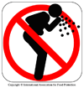
Employee Illness – Reportable Symptoms
  Vomiting
  Diarrhea
  Jaundice
  Sore Throat with a Fever
  Lesions with pus or infected wounds that are open or draining
Exempted Food Service Worker Training Presentation Rev. 0
Notes:
Speaker Notes:
As stated on the previous slide, there are certain symptoms that you must report as an employee who works with food. These are the specific symptoms we were referring to.
Remember, it is your responsibility to report to the manager if you’re experiencing any of these symptoms…regardless of the reason for the symptoms.
Depending upon the symptoms and timing of the symptoms, your manager will have to exclude you from work, or restrict you from certain duties. Again, this is very detailed, so we’re not going to cover it today.
Read 1-4. Elaborate if you wish.
Read 5. If you have lesions with pus or infected wounds that are open or draining, there are certain things that can be done so that you can keep working. These include:
a. If it is on your hands or wrists: you can cover it with a waterproof/leakproof cover (such as a finger cot) and a single-use glove over it
b. If it is on exposed portions of your arms: you can cover it with a waterproof/leakproof cover (such as a waterproof bandage)
c. On other parts of your body: you can cover it with a durable, tight-fitting bandage
Helpful Hints:
Employees may not want to report illness and/or symptoms to managers for fear of lost hours and wages. However, it is critical that employees experiencing these symptoms, or the illnesses (including exposure) on the next slide are restricted or excluded as outlined in the NM Food Regulations.

Slide 12
Sick Employee Exclusion
  Food Employees diagnosed by a doctor (or who have been exposed to) with one of the following may require restriction or exclusion from work:
    Norovirus
    Hepatitis A
    Shigella
    E. coli (Shiga toxin producing)
    Salmonella (Typhi and Non-Typhi)
Source: https://www.env.nm.gov/fod/Food_Program/documents/FieldGuide_Version_2.0_061316.pdf
Exempted Food Service Worker Training Presentation Rev. 0
Notes:
Speaker Notes:
If you, as a food employee, have been told by a doctor that you have one of the listed illnesses, you must be excluded from work until certain requirements are met to return.
We are not going to go over the requirements to return today because they are very detailed, but if this situation ever comes up, we will be following the requirements for exclusion and removal of exclusion in the NM Food Regulations.
The important thing to remember is that if you have a symptom or illness or have been exposed to one of the illnesses we discussed – you must report it to your manager.
Helpful Hints:
Symptoms and Illnesses: 2-201.11
Excluding and restricting employees due to illness: 2-201.12
Removal or adjusting exclusions or restrictions: 2-201.13

Slide 13
Handwashing: Why is it Important?
  Good Handwashing is essential for safe food operations.
  Hands are vehicles that transport millions of germs that lurk on your hands throughout kitchen.
  Handwashing helps stop contamination.
  Employees must know:
    How to wash your hands.
    When to wash your hands.
Exempted Food Service Worker Training Presentation Rev. 0
Notes:
Speaker Notes:
Handwashing is simple, but is often not done enough or correctly.
Read line. Handwashing is important for your health and for the health and safety of those your serving for to. It’s not only important to wash your hands, it’s important to do it correctly when you do wash.
Read line. Hands are an ideal way to spread (or transfer) harmful bacteria to others through food.
Read line. Proper handwashing can help significantly reduce the chance of foodborne illness.
Read line. As mentioned a moment ago, proper handwashing includes both washing at the appropriate times and washing correctly.
Let’s take a look at the proper handwashing procedure and when it’s appropriate to wash…

Slide 14
The 5 Steps of Good Handwashing
  Rinse your hands and the exposed portions of your arms with water
  Apply Soap
  Scrub your hands and the exposed portions of your arms for at least 15 seconds
  Rinse with lots of water
  Dry thoroughly
Exempted Food Service Worker Training Presentation Rev. 0
Notes:
Speaker Notes:
Washing your hands properly is simple and can significantly help protect health. Let’s take a quick look at the proper procedure:
Read line. Make sure your hands and the exposed portions of your arms are completely wet. Use warm to hot water to wash.
Read line. Most people use liquid soap, but any soap is ok. Make sure to get plenty of soap on your hands and the exposed portions of your arms.
Read line. Vigorously scrub (vigorous means fast and with pressure) your hands and the exposed portions of your arms. This is key to proper handwashing. Scrubbing vigorously creates friction which helps cut through grease/oil and loosen contamination on your hands. Make sure to scrub your fingers, areas between your fingers, and underneath your fingernails thoroughly as well as contamination often “hides” in these areas. People have said that singing “Happy Birthday” twice or the “ABC’s” once will assure you’ve scrubbed long enough.
Read line. Make sure to remove all of the soap from your hands and the exposed portions of your arms.
Read line. Most often people use single-use paper towels, which is acceptable. If you utilize heated-air devices: In addition to single-use paper towels, we’re also allowed to use heated-air drying devices.
Helpful Hints:
People often ask “Can I use hand sanitizer instead of washing my hands?”. The answer is “No”. Hand sanitizer can be used after properly washing your hands, but not in place of properly washing your hands.

Slide 15
When to Wash your Hands
  Before engaging in food preparation
  After touching bare human body parts other than clean hands and clean, exposed portion of arms
  After using the restroom
  After caring for or handling service animals or aquatic animals
  After coughing, sneezing, using a handkerchief or disposable tissue, using tobacco, eating or drinking
  After handling soiled equipment or utensils
  When switching between working with raw food and working with ready to eat food
  Before wearing gloves to initiate a task that involves working with food
  After engaging in other activities that contaminate the hands
Exempted Food Service Worker Training Presentation Rev. 0
Notes:
Speaker Notes:
There are a number of scenarios when you should wash your hands. Let’s discuss them:
Read line 1. This is important to ensure you do not cross contaminate any food when you start any kind of food preparation.
Read line 2. Your skin can be a carrier for germs and can contaminate your hands. Be sure to wash your hands after touching your skin!
Read line 3. A lot of people use the same restroom in an establishment, meaning there are a lot of germs in the restroom. You do not want to carry other people’s germs on your hands when you prepare food.
Read line 4. Service animals spend time in various locations, meaning they are also carriers for germs. To prevent contamination after handling a service or aquatic animal, wash your hands!
Read line 5. When you sneeze or cough you might use your hands to cover your mouth or nose. Wash your hands when this happens to ensure you do not contaminate food. Eating, drinking or chewing tobacco involves the use of your hands to deliver an item to your mouth. Wash your hands after these activities to ensure your hands don’t have germs.
Read line 6. Soiled equipment or utensils have food residue that can harbor germs. If you touch soiled equipment or utensils your hands will also carry those germs. Be sure to wash your hands.
Read line 7. Raw food such as poultry and meat are at risk for being carriers of bacteria that cause consumer illness. Be sure to wash your hands to prevent contaminating ready to eat foods with illness causing bacteria after you work with raw foods.
Read line 8. Gloves do not 100% prevent germs from contaminating food. If your hands are dirty with soiled food or you just used the restroom, germs will still be spread. Gloves can be used as an extra measure of preventing contamination, but does not replace handwashing.
Read line 9. This can include throwing the trash in the dumpster, handling chemicals or pesticides, or even shaking someone’s hand.
Helpful Hints:
Remember hands are the vehicles that germs use to contaminate surfaces. Stop the free ride by washing your hands!

Slide 16
Cut and Wound Care
  Wounds MUST be covered and protected because:
    Bacteria can come out of wounds and contaminate food.
    Bacteria can contaminate the wound and make YOU sick.
  How to PROTECT yourself and your customers:
    Wash hands and dry
    Apply a bandage to cover the whole wound.
    Apply a waterproof cover, like finger cots or stalls.
    Wear plastic gloves or splash guard over wound covering.
Exempted Food Service Worker Training Presentation Rev. 0
Notes:
Speaker Notes:
Cuts, scrapes and burns are common injuries in food service establishments. Knives slip, grease splashes, accidents happen. We will cover what to do in the case of an injury.
Read line 1. If you bleed in a food preparation area make sure to properly clean and sanitize the entire area. Any food that may have come into contact with blood must be discarded.
Read line 2 and line items a-d. These steps are essential for contamination prevention. Notify a Supervisor if there are no bandages or waterproof covering available.

Slide 17
Bare Hand Contact with Food
  Up to 10 billion virus particles are left on your hands. Handwashing only removes 10 thousand.
  Preventing contamination with ready to eat foods
    Single use gloves
    Dispensing equipment
    Deli tissue
    Spatula/tongs
Exempted Food Service Worker Training Presentation Rev. 0
Notes:
Speaker Notes:
Read slide intro. Up to 10 billion virus particles are left on your hands. Handwashing only removes 10 thousand. That leaves a lot of germs that can make you and your customers sick.
Limiting bare hand contact with ready to eat food can help prevent the germs from causing illness. We’ll discuss additional barriers of protection.
Read line 1.
Single use gloves can be used when handling ready to eat food such as assembling a salad.
Examples of dispensing equipment are delivery chutes for ice, drinks, dried goods, etc.
Using deli tissue to grab baked goods is a common practice that prevent bare hand contact with ready to eat foods.
Garnishing foods and drinks are common violators for bare hand contact with food. Use spatulas or tongs for this kind of task.

Slide 18
Glove Usage- Do’s and Don’ts
  Do - Wash your hands before wearing gloves.
  Do - Change gloves between job tasks.
  Do - Check your gloves for damage
  Don’t - Grab clean gloves with soiled hands.
  Don’t - Remove your gloves and try to re-use them.
  Don’t - Use gloves if they’re torn or damaged.
Exempted Food Service Worker Training Presentation Rev. 0
Notes:
Speaker Notes:
Gloves are essential for preventing bacteria and viruses on your hands from contaminating food. We will discuss the right and wrong way to use gloves in a food establishment.
Read line 1. Washing your hands before wearing gloves prevent germs from getting on the outside of the glove.
Read line 2. This includes when you are handling ready to eat foods and have to work with raw foods but plan to switch back to read to eat foods. If you are working with ready to eat foods and have to take out the trash you will need to wash your hands and change gloves before continuing.
Read line 3. To prevent further contamination from gloves check them for tears and have holes. Change your gloves if you see holes or tears.
Read line 4. You will contaminate the clean gloves with soiled hands, and potentially cross-contaminate food you are preparing.
Read line 5. Remember gloves are for single use only. You can not remove them after working with foods and put them back on.
Read line 6. Parts of your hand will be exposed and touching the food directly. This could lead to cross-contamination.
Helpful Hints:
Proper glove usage protects BOTH you, your family and your customers from getting sick!

Slide 19
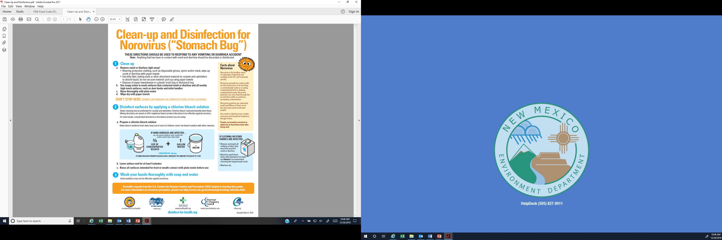
Vomit/ Diarrhea Clean-up Procedure
https://waterandhealth.org/resources/posters/
Exempted Food Service Worker Training Presentation Rev. 0
Notes:
Speaker Note:
The Food Code requires a food establishment to have a written procedure for cleanup of vomit and diarrheal events.
Procedures to minimize the spread of the contamination. This procedure outlines the steps and materials to properly clean up a vomit or diarrhea accident. It is important for the procedure to followed to protect employees, customers, food and the establishment from exposure.
Helpful Hints:
Make sure staff know what to do, especially the Person in Charge. Remember, gloves protect you, but don’t contaminate surfaces with them. Use strong bleach solutions. Follow the guidelines.

Slide 20
    Section 2:
    Cross Contamination Prevention, Cleaning and Sanitizing
(Applicable to all Food Service Workers)
Exempted Food Service Worker Training Presentation Rev. 0

Slide 21
Cross-Contamination Prevention
  Clean and Sanitize
    After preparing raw meats or allergens.
    Before working with ready to eat foods.
  Separation & Storage
    Separation
    Storage
  Ensure equipment is smooth and easily cleanable
    Avoid using wood utensils and equipment.
    Only use equipment in good shape and undamaged.
  Wash Hands and change gloves, if required, between tasks
Exempted Food Service Worker Training Presentation Rev. 0
Notes:
Speaker Notes:
Cross-Contamination is one of the main factors in causing foodborne illnesses. These four simple tips are measures food employees should take to ensure food is not contaminated by pathogens, chemicals or allergens. Let’s discuss:
Read line 1. Cleaning and sanitizing utensils and work stations between certain tasks is crucial in preventing cross-contamination.
Read line. Raw meats can carry bacteria that can contaminate the utensils and work surfaces the contact. Because of this, cleaning and sanitizing after handling any kind of raw meat is important.
Read line. Make sure your utensils, work station and hands are clean before working with any read to eat foods. Ready to eat foods will not go through a cooking process to reduce bacteria if it becomes contaminated.
Read line 2. Separation of food is another measure employees must take in preventing cross-contamination. There a number of scenarios in which this could happen
Read line. Raw foods should be kept separated from ready to eat foods. Group food with the same cook temperatures together.
Read line. To ensure the prevention of cross-contamination store raw foods below produce and cooked foods. During storage make sure all food containers are covered or wrapped.
Read line 3. You should frequently check the condition of utensils and equipment used in your establishment.
Read line. Wood is considered a porous non-cleanable surface. If bacteria gets onto wood utensils and equipment it will grow and contaminate future food that comes into contact with them.
Read line. Look for cracks, excessive wear and chips during equipment and utensils inspections. Bacteria can harbor in areas of utensils and equipment that are cracked or chipped. Let a supervisor know if you find equipment or utensils that are damaged.
Read line 4. Handwashing must always be done when changing tasks. For example, if you are preparing raw chicken by rubbing seasonings and cutting it into small pieces you will need to wash your hands, utensils and work space when moving on to prepare a salad. Gloves are then required if that salad is not going through a cooking step.
Note: Gloves are not required to handle raw foods, but are required if you plan to handle ready to eat foods with your hands.

Slide 22
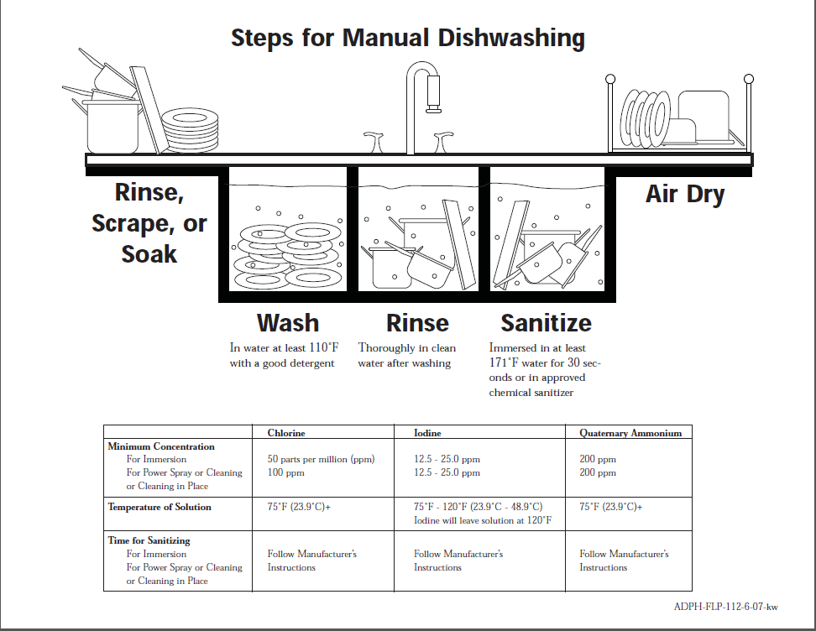
Source: https://www.alabamapublichealth.gov/foodsafety/assets/DishwashingDiagram.pdf
Note document content has been modified.
How to Clean and Sanitize
1)
5)
2)
3)
4)
200- 400ppm (see label)
Exempted Food Service Worker Training Presentation Rev. 0
Notes:
Speaker Notes:
Properly cleaning and sanitizing food utensils and dishes used in a food establishment is critical in preventing cross-contamination of bacteria or allergens. We will discuss the 5 steps involved in cleaning and sanitizing using a 3-compartment sink.
The 5 steps to manual warewashing are:
Rinse, scrape or soak dishes to remove food residue. Doing this makes the wash process (#2) more effective and keeps the wash water clean for a longer period of time.
Wash dishes with warm water that is at least 110°F and approved detergent (soap). Make sure to scrub each dish with pressure and thoroughly to wash all of the items. Make sure to focus on edges that may be a little difficult to reach.
Rinse the dishes in clean, hot water to remove the soap. Make sure the dishes are completely rinsed before sanitizing them.
Sanitize the dishes in an approved sanitizer at the proper concentration. Be sure to read the chemical label to determine the correct temperature and concentration needed to be effective. Ensure the chemicals are approved for food establishments. Assure dishes are fully submerged in the sanitizer solution for the proper amount of time.
Air dry the dishes. Air drying the dishes assures they are not re-contaminated by a dirty towel and also assures the sanitizer evaporates before use.

Slide 23
Tips for Preparing Sanitizer Solution
  Only use sanitizer that’s approved for use by your establishment
  Add water to the sink or container for solution
  Add the sanitizer into the sink or container of water
  Check the sanitizer concentration using the designated test strips
  Ready for use
Exempted Food Service Worker Training Presentation Rev. 0
Notes:
Speaker Notes:
The concentration of a sanitizer is crucial in reducing bacteria that is on the surface. If a sanitizer is not properly prepared it will be ineffective at removing bacteria and could be a reason consumers get ill in a food establishment or could be toxic and hazardous to consumers. We will discuss tips to properly prepare a sanitizer solution.
Read line 1. The sanitizer your establishment uses must be approved for food establishments. The three common sanitizers used in food establishments are Chlorine, Quaternary Ammonium and Iodine.
Read line 2. To prepare the solution, add water to the designated sink or container. The temperature of the water will vary depending on the sanitizer. Use room temperature water for Chlorine. Read the label on the container to determine the water temperature requirements for Iodine and Quaternary Ammonium sanitizers.
Read line 3. (See Helpful Hint #1 below before proceeding) Slowly pouring the sanitizer into the water will make sure you don’t add too much (that would make it harmful). It’s easier to add more sanitizer than it is to remove solution and add more water.
Read line 4. Each type of sanitizer has specific test strips, be sure to use the correct ones. The desired sanitizer concentration is different for each type of sanitizer. The concentration range for Chlorine is 50-100 ppm. For Iodine the range is between 12.5 MG/L – 25 MG/L (milligrams per liter). Quaternary ammonium is specific to the type of brand, but generally falls between 200-400ppm. Be sure to read the label to get the exact concentration requirement.
Read line 5. You can now safely use the sanitizer to properly sanitize items.
Helpful Hints:
1) It is recommended that facility owners/managers find a method for staff to consistently make sanitizer at the proper concentration. An example of how this could be accomplished is to fill the third compartment of the 3-compartment sink to a certain line (you can draw it) and then determine what measuring instrument (for example 1/4 cup measuring cup) would make the proper concentration. After determining what to use, write “For Sanitizer Only” on the instrument to assure it’s only used to measure sanitizer when made.
2) Always read the label for instructions on preparation and concentration requirements. Remember each sanitizer is different.

Slide 24
Chemical Storage, Usage and Labels
  Chemicals must be stored to prevent contamination of food, equipment, and utensils.
  Sanitizers and Detergent should be stored under the 3 compartment sink or in chemical storage.
  Dangerous Chemicals, such as gas, paint and motor oil, should be stored outside food establishments.
  Pesticides and Herbicides - Usage
  Secondary Containers - Labeling
Exempted Food Service Worker Training Presentation Rev. 0
Notes:
Speaker Notes:
Employees need to know what chemicals are allowed in a food establishment and how they need to be stored.
Read line 1. Properly storing these chemicals will ensure they do not contaminate clean dishware or food.
Read line 2. This is to prevent accidental use of nonapproved chemicals in food areas.
Read line 3. Pesticides can be used by employees if they are labeled for “food establishments”. Do not spray pesticides directly on food or food contact surfaces. Only a certified operator can apply restricted pesticides or herbicides in the food establishment. Certified operators are aware of the dangers involved if they are applied incorrectly in food establishments.
Read line 4. All secondary containers must be labeled with the name of the chemical. This is for easy identification and prevention of accidental misuse.
Helpful Hints:
Only trained employees should handle chemicals. Be sure to always read the label and handle appropriately.

Slide 25
Food Allergens and Control Measures
Milk Allergy The most common food allergy for infants and young children. | Wheat Allergy A common allergy in children that can be outgrown after the age of three.
Tree Nut Allergy Includes pecan, walnut, almond, cashew, pistachio. (Peanuts are NOT tree nuts) | Shellfish Allergy A common allergy to foods like crab, shrimp, lobster and molluscan shellfish like mussels.
Fish Allergy Allergy to fin fish like salmon and tuna to name just two. | Peanut Allergy A very common allergy.
Egg Allergy The second most common allergy in children. | Soy Allergy A common allergy for children and infants.
The
8 Major
Allergens
  Controlling Allergens
  Make sure all surfaces that the allergen food has touched are washed, rinsed and sanitized before preparing other foods!
  Use different utensils or wash, rinse and sanitize them.
Exempted Food Service Worker Training Presentation Rev. 0
Source: www.foodallergy.org/common-allergens
Notes:
Speaker Notes:
Discuss the Chart Items First:
There are 8 food groups that cause 90% of the food allergies in the United States. They are milk, tree nuts, eggs, soybean, peanuts, wheat, fish and shellfish (lobster, crab, shrimp, mussels, and molluscan shellfish)
These food allergies are present in 1 in 13 children or roughly 2 kids per class
To prevent allergen cross contamination in the work environment follow the 2 steps listed.
One method to prevent allergen cross contamination is to use the proper method for washing, rinsing and sanitizing all surfaces/utensils the allergen has contacted before preparing other foods on the same surface. Follow the same process we discussed on slide #22 to wash, rinse and sanitize surfaces.
The second method is to use different (or dedicated) utensils for allergen containing foods. Examples of dedicated items is only using certain cutting boards, knives and tongs for a single allergen food.
***IMPORTANT*** Whether you choose to follow #1 or #2 above, it’s important to remember that each allergen food must be kept separate from each other and from other non-allergen foods. For example, just because fish and wheat are both major allergens doesn’t mean they can contact each other. They must be kept separate from each other just like allergen and non-allergen foods must be kept separate.
Helpful Hints:
Always know what foods and ingredients you are using in the kitchen. If they contain 1 of the 8 major food allergens make sure to control cross contamination by following one of the 2 methods discussed.
If you choose to follow #2 and have dedicated equipment/utensils, make sure they are clearly marked and everyone understands which items should be used with which foods.
Read the label or ask your supervisor if you don’t know the ingredients.

Slide 26
    Section 3a:
    Basic Food Time and Temperature Control
(Applicable to all Food Establishments Types)
Exempted Food Service Worker Training Presentation Rev. 0

Slide 27
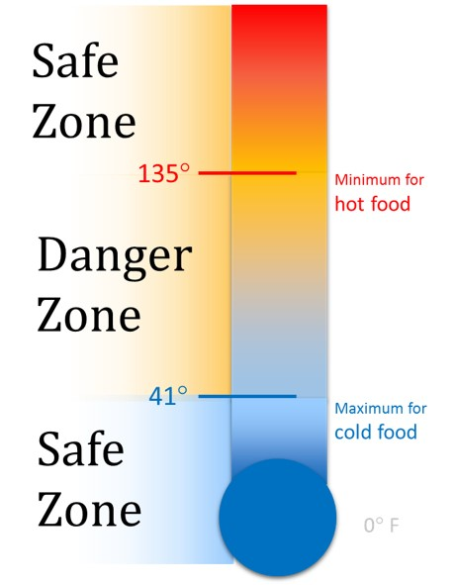
Importance of Time and Temperature
  Keep foods out of the Danger Zone
    Hot Foods 135ºF or above
    Cold Foods 41ºF or below
    Frozen Foods
  Cooked foods date marking and discard date.
  Commercially packaged ready-to-eat foods date marking and discard date.
Exempted Food Service Worker Training Presentation Rev. 0
Notes:
Speaker Notes:
Bacteria grow quickly at, or near, room temperatures. Because of this, it is important to maintain food at proper temperatures at all times.
The danger zone is a range of temperatures that fall between 41ºF and 135ºF. It’s called the danger zone because this temperature range is ideal for the bacteria to survive and grow. Food that is kept within this range are likely to grow bacteria quickly and make people sick. Following the guidelines below will help prevent bacteria from growing in food.
Food that has been cooked/heated/reheated and will not be served immediately must be held at 135ºF or above. Remember, keep hot food hot.
Food that requires refrigeration (examples: cheese, meat, and eggs) must be held at 41ºF or below. Remember, keep cold food cold.
Frozen foods should be maintained frozen. A specific temperature isn’t required, but items should remain frozen solid.
When you fully cook food and then cool it to hold more than 24 hrs, you must label the food with the day or date by which it must be used or disposed. Food fully cooked and cooled must be used or disposed within 7 days. The date of preparation counts as day 1. For example, if you prepared a food on Monday, the day it must be used or disposed by is the next Sunday.
Ready-to-eat foods packaged by commercial manufacturers that are received and opened must be marked with the date the original container was opened. If the item is held for more than 24 hours, it must then be marked and served or discarded as outlined in #2 above. There are some exceptions to this rule (one example: commercially processed chicken salad) that can be identified in 3-501.17 of the 2019 Retail and Manufactured Food Field Guide.
Helpful Hints:
You can look at the label for temperature requirements if you are not sure. Look for key words such as: "Keep Refrigerated”, “Keep Frozen”, or “Refrigerate after Opening”.

Slide 28
Cold Holding Tips
  Tips:
  Use metal containers with plastic lids, when possible.
  Check food with a thermometer.
  Keep refrigerator doors closed
Exempted Food Service Worker Training Presentation Rev. 0
Notes:
Speaker Notes:
Cold holding challenges can arise at any given time. We will discuss tips to help control and maintain proper temperature for cold food.
Read line 1. Metal is best to help “keep cold food cold” because it allows cold air to pass through it the best. Plastic insulates and does not allow cold air to pass through it as easily.
Read line 2. A refrigerator thermometer is not always reliable since it not calibrated. If you use your hand held calibrated thermometer, you can assure the temperature of the food is accurate. Routinely monitoring food will
Read line 3. Every time the refrigerator opens, food can warm up by letting the cold air escape the unit. That is why it is important to maintain the doors closed when you are not using foods in the refrigerator.

Slide 29
Hot Holding Tips
  Tips:
  Use metal containers with plastic lids
  Cover containers
  Check food temperature regularly
  Stir uncovered food often
  Check water in the steam table
Exempted Food Service Worker Training Presentation Rev. 0
Notes:
Speaker Notes
It is important to keep hot foods hot to keep bacteria from growing quickly, but there are times when you might encounter some challenges with this. We’ll be discussing tips to ensure proper hot holding temperatures are maintained.
Read line 1. Metal is best to help “keep hot food hot” because it allows hot air/steam to pass through it the best. Plastic insulates and does not allow hot air/steam to pass through it as easily.
Read line 2. Cover containers when you are not working with food in them. This will help trap the heat in the container and the food in the container will stay hotter.
Read line 3. Using a calibrated thermometer, periodically check the food that it being held. This is an extra measure that will help ensure the food is kept at 135ºF or above.
Read line 4. Food on top of a hot holding container is prone to getting cold because of ambient air. Stirring the container often will help keep the food on top from getting too cold.
Read line 5. If you are using a steam table to keep food hot you must ensure there is enough water for the unit to work properly. Replace evaporated water with hot water as needed.

Slide 30
Receiving Temperature Controlled Foods
    If foods must be cold, then receive below 41ºF
    If foods must be hot, then receive above 135ºF
    If labeled “keep frozen”, then must be received frozen solid.
    Reject foods not held at these temperatures.
  Look for signs of abuse such as ice crystals, heavy condensation, or damaged/opened containers
Exempted Food Service Worker Training Presentation Rev. 0
Notes:
Speaker Notes:
Temperature plays an important role in food safety. The first step in protecting food is ensuring it is received at the proper temperature.
Read slide. If you receive food that is not held at the appropriate temperature, then you could be passing unsafe food to your customers.
Helpful Hints:
Think of the food you receive and the temperature it should be at. Check with a thermometer if you have doubts.
If you notice signs of possible temperature abuse (ice crystals or heavy condensation) the product may need to be rejected. Contact a manager for further assistance.
If you notice signs of possible contamination (damaged or open containers) you should reject the product. Contact a manager for further assistance.

Slide 31
Using Time as a Public Health Control
  Time can be used for Public Health Control if foods are held for less than:
  4 hours: If the time began when the food was below 41ºF or above 135ºF. (Outside the Danger Zone)
  6 hours: If the time began when the food was below 41ºF and never exceeds 70ºF.
Exempted Food Service Worker Training Presentation Rev. 0
Notes:
Speaker Notes:
Note: Only cover this information if employees will be using time as a control for safety.
Using time as public health control should only be used if there is a plan in place for employees to follow. Let’s go through the two options that can be used:
Read line 1. The food shall be marked or otherwise identified to indicate the time that is 4 hours past the point in time when the food is removed from temperature control. The food must be discarded once the 4 hours have been reached.
Read line 2. For this method, you will also need to mark the food with the discard time being 6 hours past the point in time when the food is removed from temperature control. However, it must be discarded if the food exceeds 70ºF.
***IMPORTANT*** A food establishment that serves a highly susceptible population may not use time as a public health control for raw eggs.
Helpful Hints:
Food cannot be reused or cooled once the allowed time has passed. These methods should not be used if the food is received in the Danger Zone.

Slide 32
Cooking- When to know it’s ready
Internal Cooking Temperature | Raw Animal Foods
145°F for 15 seconds: | •Raw eggs cooked for immediate service •Fish, except as listed below •Intact Meat •Commercially raised game animals, rabbits
155°F for 17 seconds: | •Ratites (Ostrich, Rhea and Emu) •Injected meats •Mechanically tenderized meats •Raw eggs not for immediate service •Comminuted meat, fish, or commercially raised game animals
165°F for <1 second (instantaneous): | •Wild game animals •Poultry •Stuffed fish, meat, pork, pasta, ratites & poultry •Stuffing containing fish, meat, ratites & poultry
Exempted Food Service Worker Training Presentation Rev. 0
Notes:
Speaker Notes:
Note: only cover the proper cooking temperatures for foods you prepare/serve.
With animal food products it is important to reach the proper internal temperatures to destroy harmful bacteria. We are about to discuss the required minimum internal temperatures for different types of raw animal foods.
First line item. The foods that require to be cooked to 145°F for 15 seconds include, raw eggs for immediate service, fish (except as listed below, intact meat, commercially raised game animals and rabbits.
Second line item. Foods that need to be cooked to 155°F for 17 seconds include ratites (ostrich, rhea and emu), injected meats, mechanically tenderized meats, raw eggs not for immediate service, and comminuted meat, fish or commercially raised game animals.
Third line item. You immediately reach the required length of cooking time once you hit 165°F. The foods required to reach this temperature are wild game animals, poultry, stuffed fish, meat pork, pasta, ratites, poultry and stuffing containing fish, meat, ratites and poultry.
***IMPORTANT*** You must always use a calibrated thermometer to check the internal temperature of food to make sure it is properly cooked.
Helpful Hints:
If you can’t remember the cook temperature for a specific food, remember 165ºF. That works for all cooking.
For further guidance on cooking temperatures (including cooking items like steak and roast beef) see Section 3-4 on page 78 of the 2019 Retail and Manufactured Food Field Guide.

Slide 33
Family Style Dining and Service Tips
  Ensure everyone washes their hands before service.
  Provide separate tongs and scoopers for each food.
  Use clean plates for each trip.
  If serving children, help serve them.
  Consume or discard foods stored at room temperature longer than 2hrs.
  Discard all uneaten food.
Exempted Food Service Worker Training Presentation Rev. 0
Notes:
Speaker Notes:
Note: Only review this slide if your food establishment serves “family style”.
Family style dining is when a food is placed on the table in large containers and diners (usually children) serve their own portions from the larger container. Although seemingly harmless, there are precautions to take to ensure the food remains safe throughout the meal. Let’s discuss those tips:
Read slide. Elaborate as you determine necessary.

Slide 34
    Section 3b:
    Advanced Food Time and Temperature Control
(Applicable to Complex Food Establishments)
Exempted Food Service Worker Training Presentation Rev. 0

Slide 35
Time/Temperature Control for Safety Food - Cooling
Cooked Time/Temperature Control For Food Safety shall be cooled:
  Within 2 hours from 135°F to 70°F; and
  Within a total of 6 hours from 135°F to 41°F or less.
Time/Temperature Control For Food Safety shall be cooled within 4 hours to 41°F or less if prepared from ingredients at ambient temperature, such as reconstituted Foods and canned tuna.
Exempted Food Service Worker Training Presentation Rev. 0
Notes:
Speaker Notes:
Properly cooling foods is an important process that prevents the food from being in the danger zone for an extended period of time and ensures bacteria does not grow in the food. If the cooling methods we are about to discuss are not followed the food can become spoiled, grow bacteria and potentially make someone sick.
Read line item 1 and subsections a and b. TCS foods that are commonly cooled include eggs, meat, poultry, fish, baked potatoes, and cooked rice. It is important to use either of these methods outlined when you are cooling any of these food. Make sure to use a calibrated thermometer for temperature accuracy throughout the cooling process.
Read line item 2. Reconstituted foods (dried foods that are rehydrated with water or other liquids to resemble their original size or texture) and canned tuna must be cooled quickly after being opened and prepared. Foods prepared in this manner have a strict 4 hour time limit to reach 41°F or less.
Helpful Hints:
To properly choose which method of cooling you must follow, always be aware of the foods you are working with. If you are unsure, ask your supervisor.
If you are preparing food like tuna that must be quickly cooled, consider pre-chilling the product cans before they’re opened for preparation. Doing so will lower the temperature of the product before preparation and will reduce the final cooling time.

Slide 36
Cooling Food - Methods
  Cool foods rapidly in smaller batches and containers.
  Use shallow metal containers (4” deep or less)
  Stir the food in a container placed in ice water bath
  Do NOT seal the container
  Adding ice as an ingredient
Exempted Food Service Worker Training Presentation Rev. 0
Notes:
Speaker Notes:
Properly cooling food is important for food safety. Unlike some bacteria that are destroyed during the cooking process, bacteria that multiples during cooling may not be able to be destroyed when reheating the food for holding/service. Let’s discuss the methods that will help you properly cool food.
Read line 1. Large batches of food or food sealed in containers cools very slow, which allows bacteria to grow rapidly. Smaller batches means cutting larger portions of meat into smaller pieces and cooling liquid substances in shallow containers (#2 below).
Food should be cooled in one of two ways listed below. In either case, use of an ice paddle in the food will speed up the cooling process.
In the walk-in refrigerator on the top shelf or speed rack away from possible contamination
In an ice bath away from possible contamination
Read line 2. This will allow the food to cool quicker.
Read line 3. When using an ice water bath to cool food, stirring it periodically will help steam to escape and for the food to cool more quickly.
Read line 4. Covering the container will trap heat, which will prolong the cooling process.
Read line 5. Using ice as an ingredient for cooling will also speed up the cooling process of the food. When using ice as an ingredient, make sure it is made from an approved drinking water source.

Slide 37
Reheating Food
  For Immediate Service: Reheat to any temperature
  For Hot Holding:
    Reheat to 165ºF for 15 seconds, or
    Microwave: Reheat to 165ºF, rotate and/or stir, and covered. Let stand for 2 minutes.
Exempted Food Service Worker Training Presentation Rev. 0
Notes:
Speakers Notes:
Food that has been cooled for later use must be reheated properly. We are going to discuss how to reheat:
Read line 1. An example of this is when a consumer orders a roast beef sandwich au jus that was previously cooked and refrigerated and you prepare it and serve it immediately after removing it from refrigeration.
Read line 2a-b. Reheating must be done rapidly and the time the food is between 41ºF and the required reheating temperature of 165ºF may not exceed 2 hours. If foods that are reheated for hot holding are not reheated to 165ºF, the slow warming could allow bacteria to grow and make people sick.

Slide 38
Questions?
Exempted Food Service Worker Training Presentation Rev. 0

Slide 39
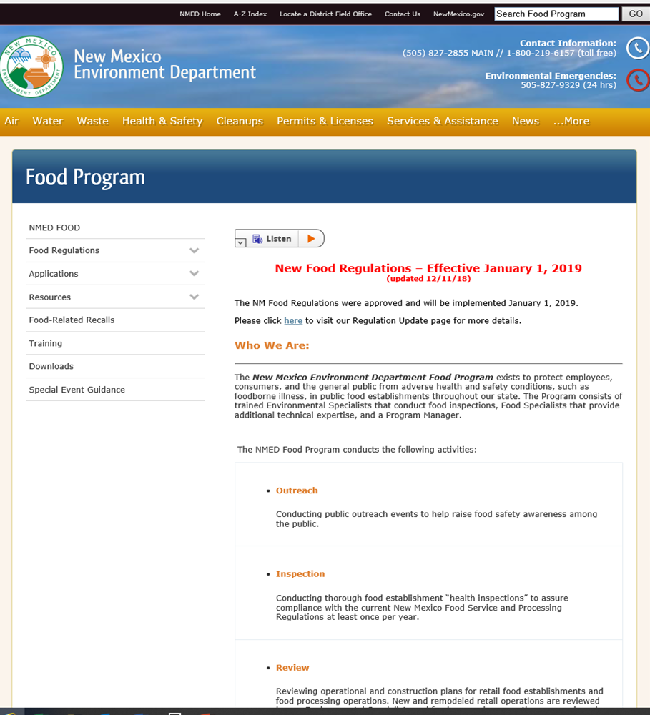
Where to find Answers:
https://www.env.nm.gov/foodprogram/
Exempted Food Service Worker Training Presentation Rev. 0
Notes:
Note: The website listed below may be used to answer additional questions a food establishment may have https://www.env.nm.gov/foodprogram/

